Slide 1
Applied Mathematics – a tribute to Leonhard Euler’s 315th birthday
Hans-Martin Hilbig

Slide 2
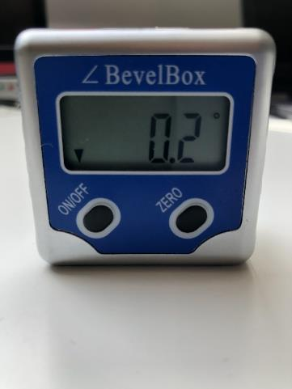
Measuring angles with the help of gravity
HMH 04/14/2022

Slide 3
Definitions: Accuracy, Precision, Resolution
Accuracy: How close is a reported measurement to the true value being measured?
Precision: How reproducible is a given measurement?
Resolution: What is the smallest change that can be measured in a given range?
HMH 04/14/2022

Slide 4
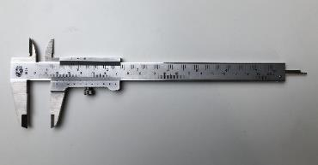
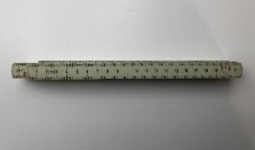
Accuracy, Precision, Resolution
Task: Measure the length of a stick 150cm long. You have a caliper and a ruler. Which one is more accurate?
Caliper:
Resolution: 0.1mm
Range: 150mm
Accuracy? Precision?
Ruler:
Resolution: 1mm
Range: 2m
Accuracy? Precision?
HMH 04/14/2022

Slide 5
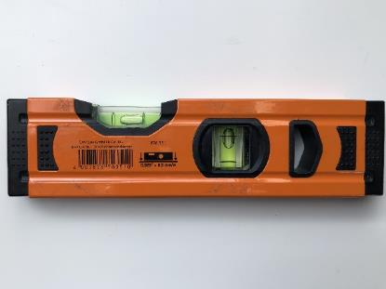
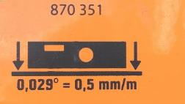
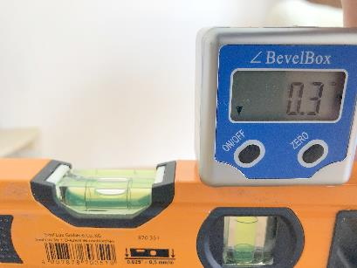
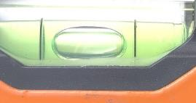
Measuring angles with the help of gravity
Spirit level
Technical accuracy of sensor on a perfectly flat surface: 0.029 Degrees
Range of spirit level: +/- 0.3 degrees
Practical accuracy of sensor applied: +/- 0.3 degrees
HMH 04/14/2022

Slide 6
Quality of electronic sensor measurements
Sensor properties affecting resolution: bit-width, range and sensitivity of the sensor
Methods to affect precision: averaging, outlier elimination, noise filtering
Methods to affect accuracy: Mathematical methods, using multiple sources from different sensors
Sensor sensitivity might not always be constant!!
HMH 04/14/2022

Slide 7
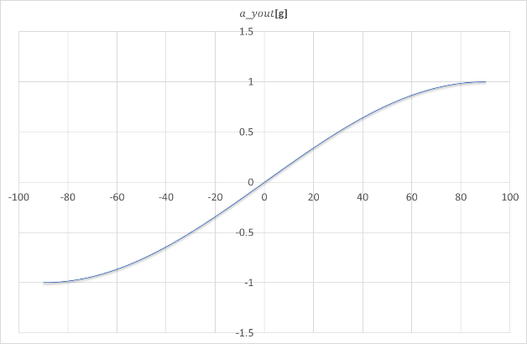
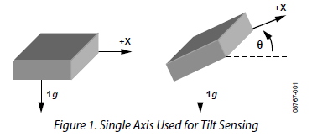
Measuring angles with an accelerometer
Single x-axis Accelerometer:
$$a_{xout}=\sin{ϴ}×g$$
Challenges:
Low sensitivity around ϴ = +/- 90 degrees
Range is limited to +/-90 degrees
Figure 1: © Analog Devices Inc.
HMH 04/14/2022

Slide 8
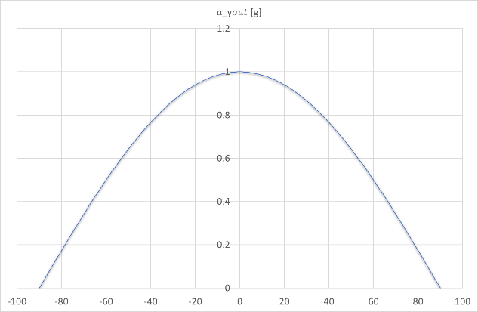
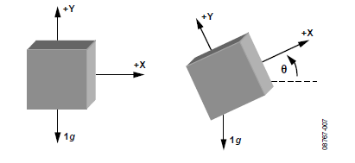
Measuring angles with an accelerometer
Single y-axis Accelerometer:
Figure 2: Two axis used for tilt sensing
$$a_{yout}=\cos{ϴ}×g$$
Challenges:
Low sensitivity around ϴ = +/- 0 degrees
Range is limited to 90 degrees
Figure 2: © Analog Devices Inc.
HMH 04/14/2022

Slide 9
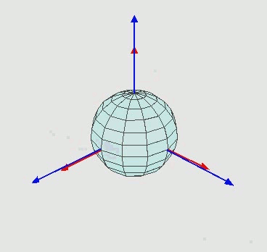
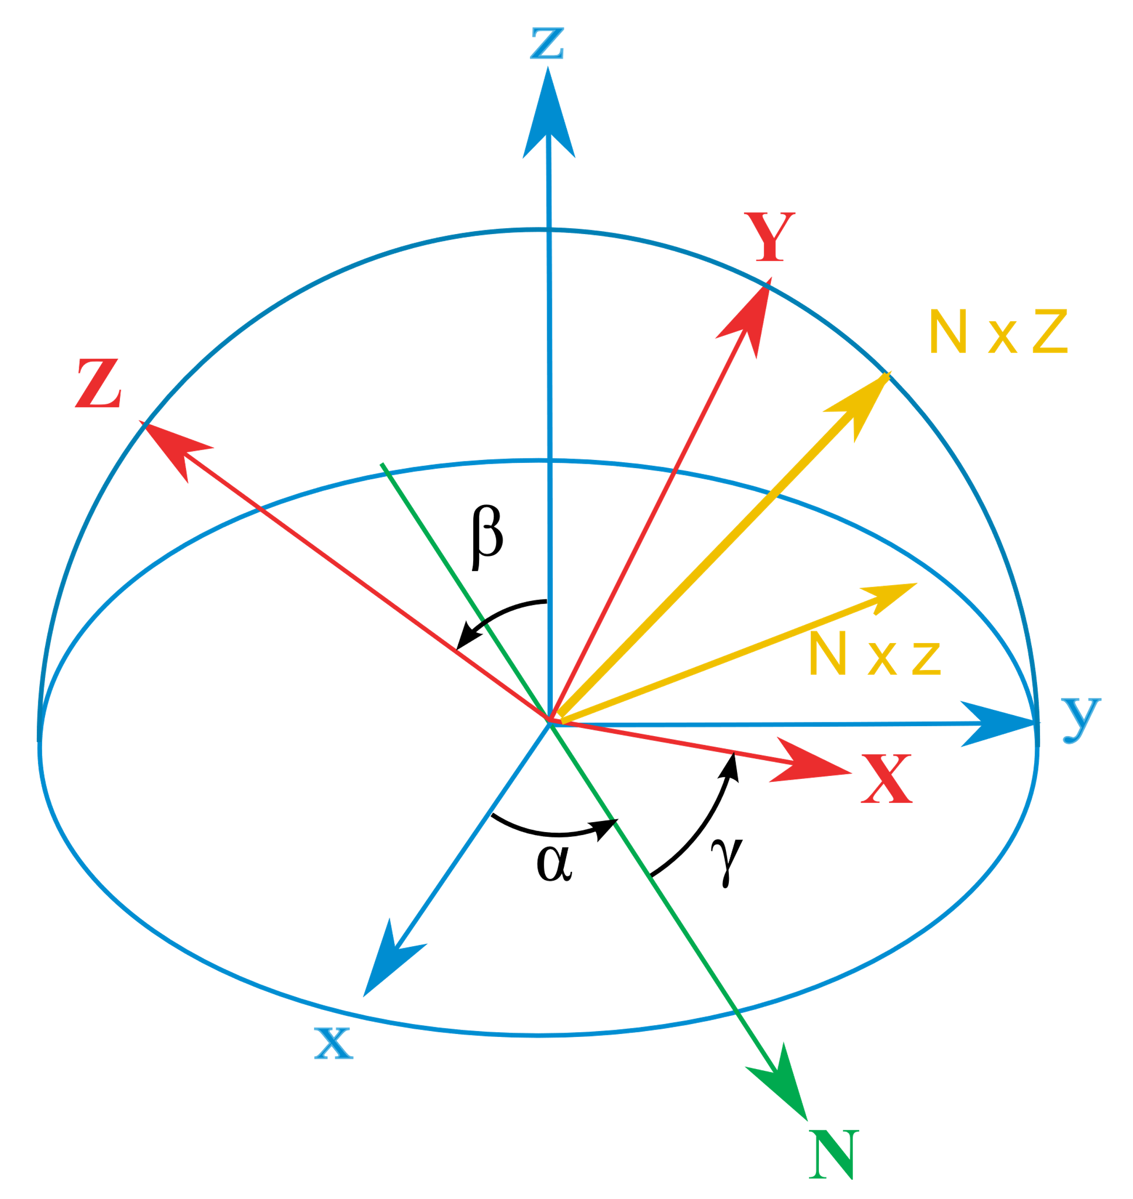
Euler angles (Wikipedia)
Any target orientation can be reached, starting from a known reference orientation, using a specific sequence of intrinsic rotations, whose magnitudes are the Euler angles of the target orientation.
By Euler2.gif: Juansemperederivative work: Xavax - This file was derived from: Euler2.gif:, CC BY-SA 3.0, https://commons.wikimedia.org/w/index.php?curid=24338647
By Juansempere - Own work, CC BY-SA 4.0, https://commons.wikimedia.org/w/index.php?curid=6767281
See: https://en.wikipedia.org/wiki/Euler_angles#Geometric_algebra
HMH 04/14/2022

Slide 10
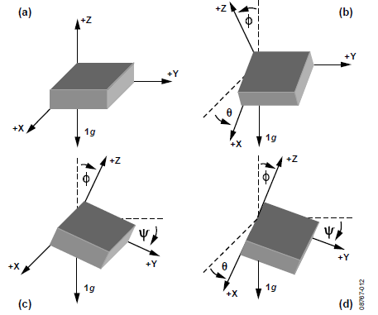
Sensor fusion based on Euler angles
$$θ=\arctan\left(\frac{a_{xout}}{\sqrt{{a^{2}}_{yout}+{a^{2}}_{zout}}}\right)$$
Benefits:
Sensor fusion compensates areas of low sensitivity
Quadrant detection extends the range to 0-360 degrees of Theta, Phi and Psi in all three spheres
Figure 3: Angles for independent inclination sensing
Figure 3: © Analog Devices Inc.
HMH 04/14/2022

Slide 11
Summary – key learnings
Accuracy depends on precision, resolution and sensitivity of sensors
Mathematical methods and sensor fusion are used to enhance accuracy of an electronic system
Euler angles applied enhance the single axis accuracy of an electronic system by using a 3-axis accelerometer
Using an appropriate tool improves accuracy!
HMH 04/14/2022

Slide 12
Helpful links
Analog Devices ADXL335 application note AN-1057: Using an Accelerometer for Inclination Sensing: https://www.analog.com/en/app-notes/an-1057.html
T³ eu, H.M. Hilbig, Veit Berger, Accelerometer library for TI-Innovator under Python: https://resources.t3europe.eu/t3europe-home?resource_id=3131&cHash=4457c1aba6400d23c4fb1674b27a2c8f
… or simply shoot me an email with questions, suggestions, feedback: hm-hilbig@web.de
Reference to pictures & graphics used in this presentation:
Graphic on slide 7: public domain, see: https://commons.wikimedia.org/wiki/File:ConstellationGPS.gif
Graphics used on slides 8,9,11: ©2010 Analog Devices, Inc. All rights reserved. Trademarks and registered trademarks are the property of their respective owners. AN08767-0-2/10(0)
All other images & graphics: created by the author (Hans-Martin Hilbig 2022)
HMH 04/14/2022

Slide 13
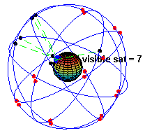
Sensor fusion to enhance accuracy
GPS:
6 x 4 satellites circle the earth twice a day in a precise orbit
Satellites periodically send their precise & accurate time and position data
A minimum of four satellites are visible from any given place on earth
Mathematical algorithms calculate the precise position and velocity on earth
Owners:
GPS (Navstar): USA
GLANOSS: Russia
Galileo: Europe
BeiDu: China
Graphic: released to public domain
HMH 04/14/2022

