Slide 1


Webinar series
2 April 2020 Pontivy France
It’s a Sticking Point

Slide 2

The meta level of CPD
Why do we teach what we teach?
Why do we teach in a particular way?
What motivates you as a teacher?
When do we engage students at different cognitive levels?
What is the accepted truth of a scientific concept?
Notes:
A non-exclusive list of questions we should be asking ourselves as teachers. Certainly as providers of CPD I consider such questions essential, but they are rarely considered. What follows considers why we might teach about friction. What is the accepted scientific truth about friction and a way of teaching through cognitive challenge. The cognitive challenge to teachers is to undo their preconceptions about the nature of force and friction.

Slide 3

Why study friction anyway?
In total, ~23% (119 EJ) of the world’s total energy consumption originates from tribological contacts. Of that 20% (103 EJ) is used to overcome friction and 3% (16 EJ) is used to remanufacture worn parts and spare equipment due to wear and wear-related failures.
Holmberg K., Erdemir A., Influence of tribology on global energy consumption, costs and emissions; Friction. September 2017, Volume 5, Issue 3, pp 263–284

Slide 4
Frictional Forces and Car Tyres: Clearing up Misconceptions
Ian Galloway
STEM lead T3 Europe
Copernican Revolutions

Slide 5

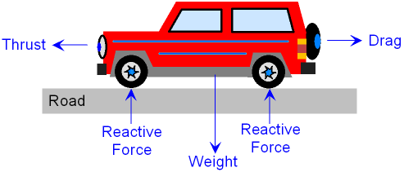
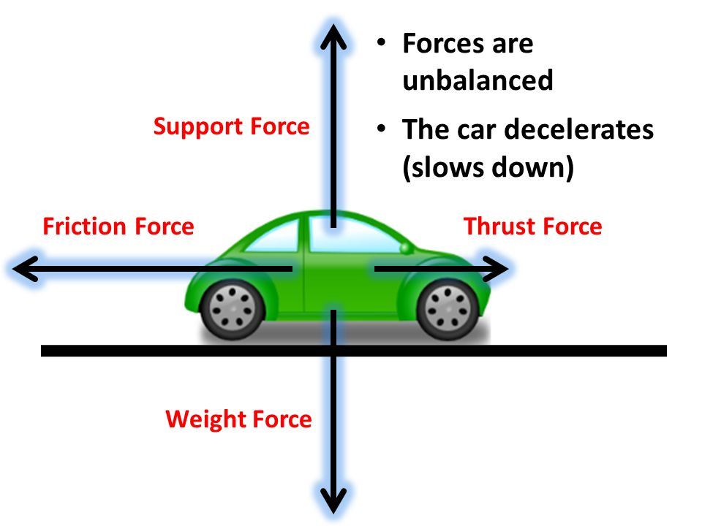
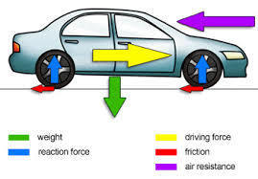
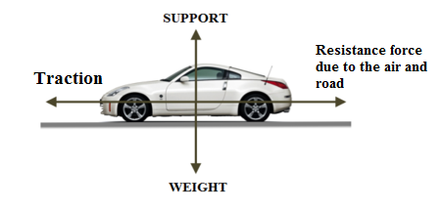
What makes a car move forwards?
Notes:
What does driving force mean? Thrust is reserved for rockets and jets. The best is the car at the bottom, but here traction (or the friction force) should be in the surface of the road and resistance force due to air is called drag. Reactive forces are better called support forces. The friction between tyres and road acts in the forward direction and is responsible for the motion of the car!

Slide 6
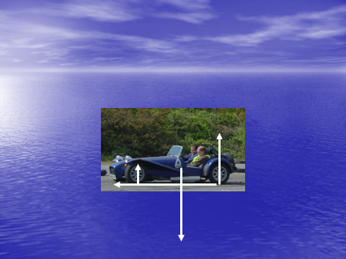
Notes:
Drag is the green arrow to the right. The friction force to the left is much larger than the drag so this car is accelerating to the left.
(Note for slide 22, that the result of the large friction force is a large supporting force on the rear wheels because the car is being rotated clockwise. The supporting force on the front wheels has reduced and so the familiar lift of the front and dip at the back occurs)

Slide 7
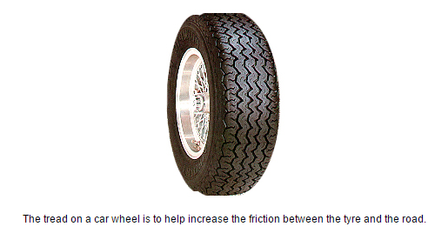
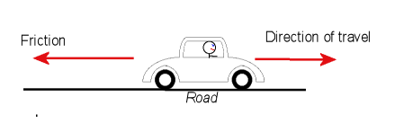
Frictional nonsense
Friction opposes motion
All wrong!
Notes:
All these statements taken from school text books are wrong. If the car was slowing down the diagram would be correct except that the friction should lie in the surface of the road. Hence friction may oppose the motion but not always! Whether or not “friction opposes motion” depends on which surface you are referring to. The only force enabling a car to accelerate forwards is the friction force between tyre and road (there is also a friction force on the road in the opposite direction!). As we shall see later the tread on a tyre has a very specific purpose and it is not to increase friction!

Slide 8
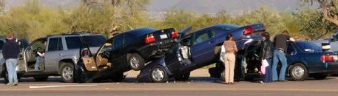
Vehicle Safety
Notes:
Too close?

Slide 9
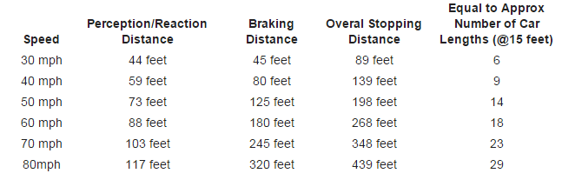
Do tyres matter?
Notes:
The units here are not important. Suffice to say that no mention of tread, size of the vehicle or width of tyre is made in these typical stopping distance tables.

Slide 10
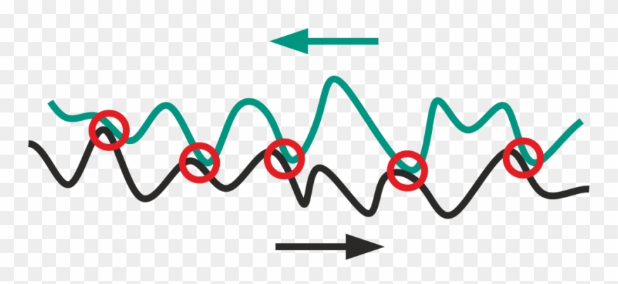
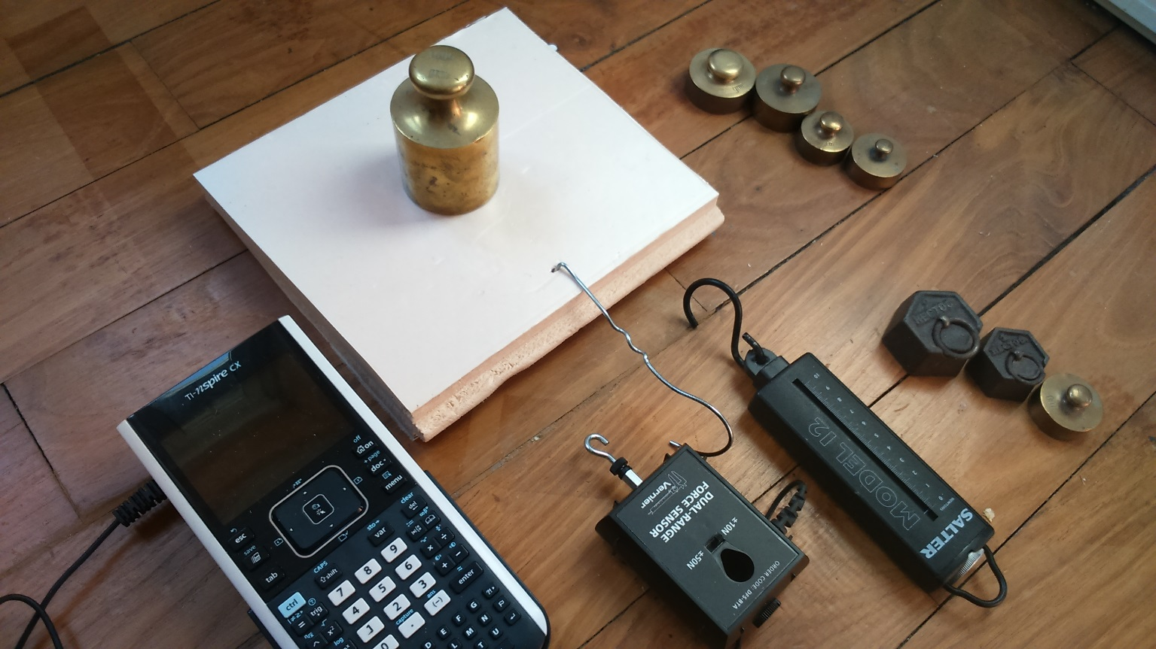
Amontons’ first law
A cognitive challenge.
Find a mathematical model to support the scientific model above.
Notes:
A typical diagram to illustrate the origin of friction. Friction is proportional to the normal force between the surfaces, but why? Devise a scientific model which results in Amonton’s first law.

Slide 11
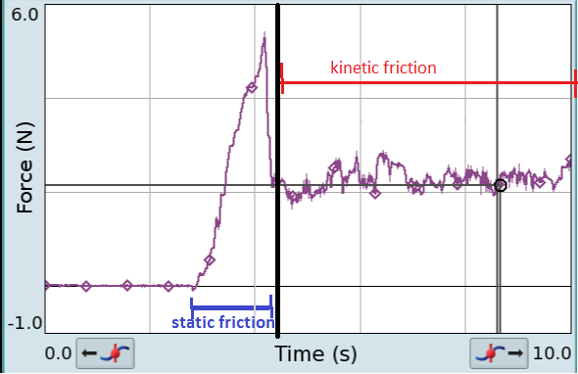
Static and dynamic
Notes:
Using the force meter it is easy to show the point at which a pulled object just begins to slip. At the point of slipping the object moves and it is easy to imagine that once moving, the asperities are easier to break or it is easier for one surface to “lift” over the asperities on the other surface. Static friction is important for car tyres, once sliding (or skidding ) begins the rubber will melt so the car now slides on a film of liquid rubber, very little friction available!

Slide 12
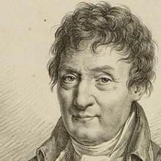
Why do we need wide car Tyres?
I know!
Amontons would invoke his second law!
But students do not yet know it!
Notes:
The cognitive challenge to students is to ask why manufacturers produce wide car tyres. They will answer “to increase friction”. The response is “how do we know that?”

Slide 13
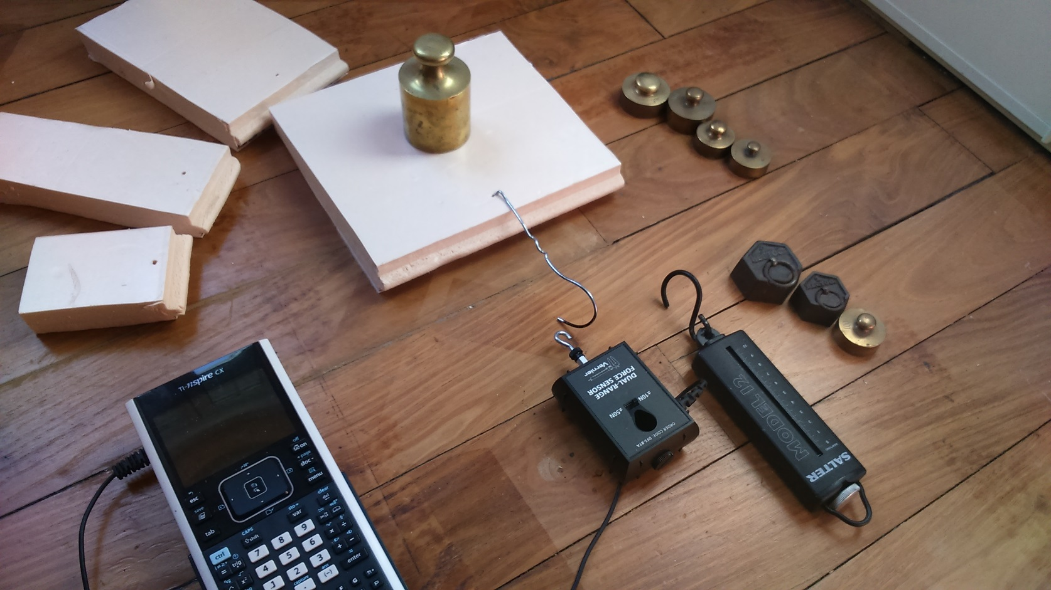
Can we verify the claim?
Use polystyrene blocks of different areas. They have little mass and so will not affect readings but serve as a convenient standard surface and sledge for masses!
The following slide suggests a table for students to fill in.
Notes:
So to verify the claim cardboard mats ( or polystyrene tiles) of different sizes are used to drag loads across the table and measure the frictional force. If the claim is true then friction should be greater for the larger mats.

Slide 14
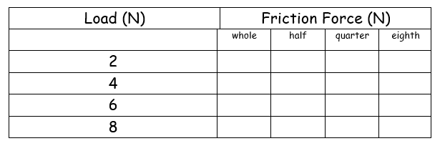
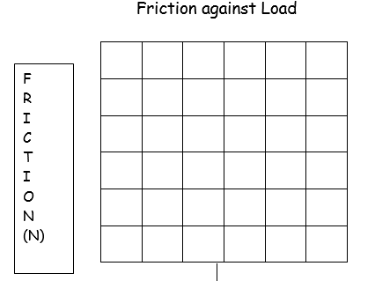
Can we verify the claim?
Notes:
So to verify the claim cardboard mats ( or polystyrene tiles) of different sizes are used to drag loads across the table and measure the frictional force. If the claim is true then friction should be greater for the larger mats.

Slide 15
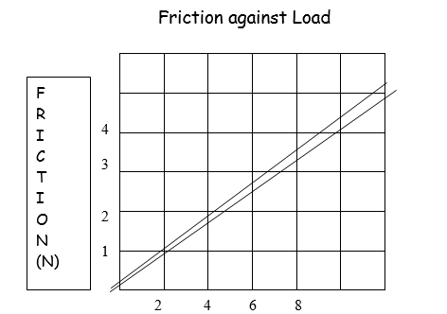
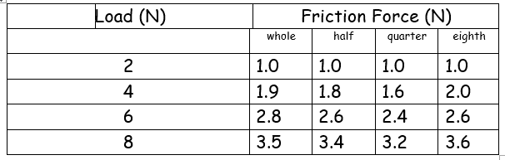
Notes:
In fact the results are the same for the different sized mats. For any one size Amonton’s first law holds but by and large the friction force for a given load is independent of the are of contact. This is Amonton’s second law and suggests that wide tyres will not provide any greater friction force.

Slide 16
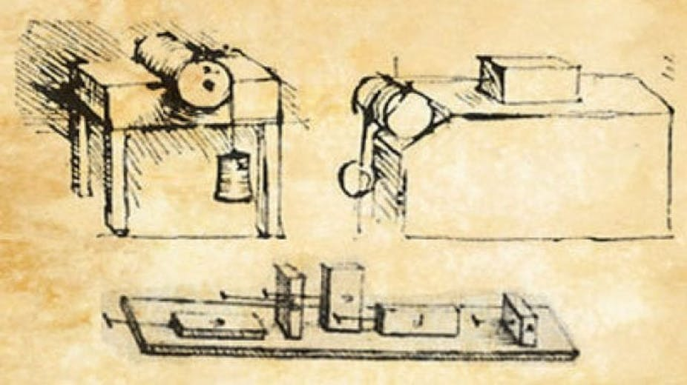
But why do we use wide tyres?
Reduce rate of wear!
Amontons’ second law, friction is independent of the area of contact.
The explanation lies in understanding the first law and follows logically.
Known to Leonardo and rediscovered by Amontons.
Notes:
Formula one cars are limited to width of tyre by rules. Good drivers attempt to reduce rate of wear through good cornering etc.

Slide 17
And the purpose of tread?
It obviously cannot increase friction!
It is only to clear water out of the way on a wet road.
Smooth or bald tyres would be just as effective as tyres with tread on a dry road (cf racing cars!)
The law requires that the tread is a minimum depth to avoid aquaplaning in the wet!
Notes:
This discussion with students is critical to alter their perceived notions of friction wide tyres and stopping distance. Stopping distances are the same for all vehicles if correctly loaded. The only force bringing a vehicle to a stop is friction between tyre and road and is independent of area of contact. It also does not depend on the weight of the vehicle as the friction available is proportional to the weight! So Lamborghini and Morris Minor both have the same stopping distance from the same speed. Lorry and car both have the same stopping distance from the same speed!

Slide 18
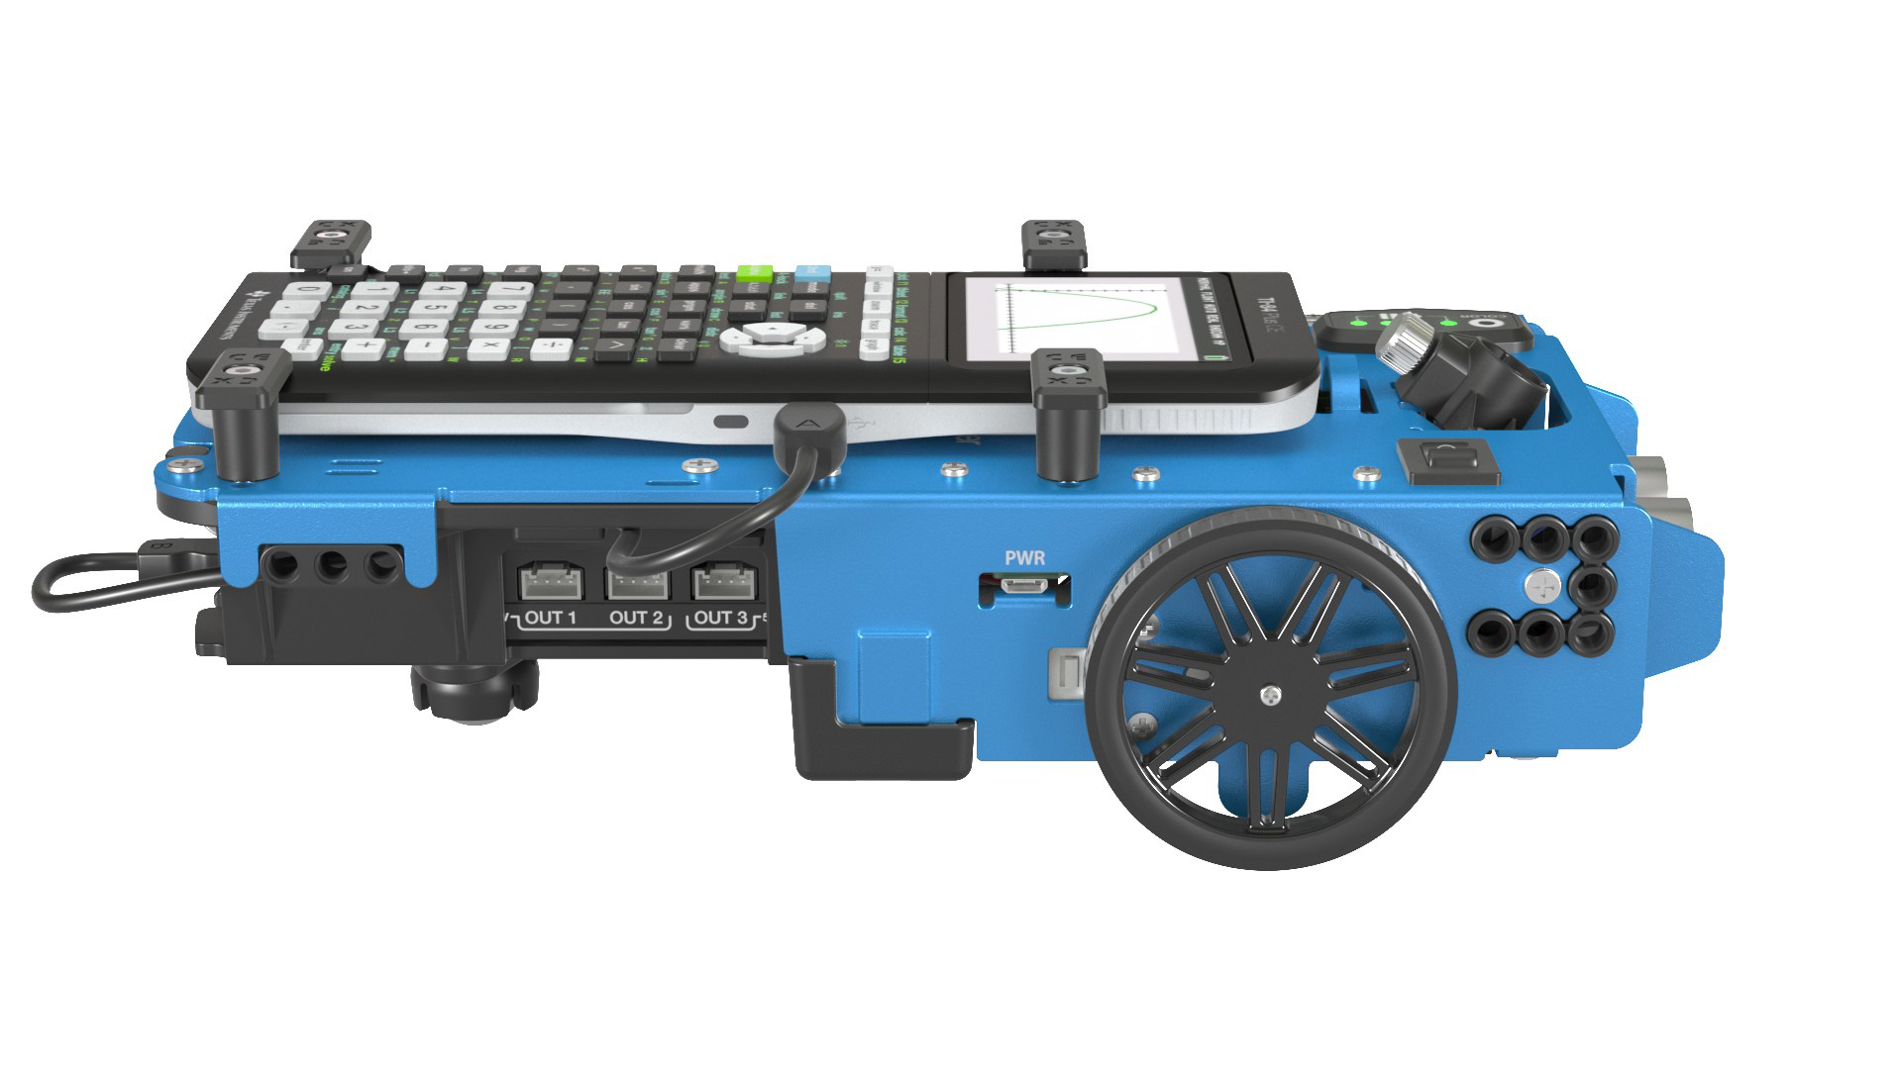
So, front or rear wheel drive?
Notes:
In the forward direction to the right in the image, the TI Rover is a front-wheel drive vehicle and measured friction is less than in the reverse direction to the left, where the TI Rover behaves as rear-wheel drive vehicle. When driven it can be held by a force meter with the wheels spinning and so the friction can be measured in both directions. Typically the friction when rear wheel driven is 30% greater. The motors will disconnect and the program will abort if the wheels stall, this is a good thing!

Slide 19
So, front or rear wheel drive?
Now we can provide an explanation in terms of moments of forces, or torques.
Notes:
Friction is the only force which accelerates the vehicle. It provides a clock-wise turning moment (or torque) around the centre of gravity. This results in the front wheels lifting and the rear wheels being pressed down. This in turn means the normal force between tyres and road is increased at the back and decreased at the front, as shown. There is therefore more friction available to a rear-wheel drive vehicle than a front-wheel drive. The normal force at the front could become zero in the case of a rear-wheel drive vehicle resulting in the now familiar ‘wheelie’.

Slide 20
Summary… Copernicus@physics.org
Tyre tread for clearing water
Friction drives car forwards (not thrust or driving force)
Friction arises from surfaces in contact (stationary or sliding)
Friction independent area contact
Equilibrium requires balanced torques as well as forces
The weight of an object does not move its line of action
Forces need names. (reaction force is not enough)

Slide 21
An explanation
Real Area, RA, supports weight W
If W doubles then so does RA
So real pressure is constant and RA ∝ W
Force Ff to break asperites ∝ RA
Therefore Ff ∝ W
More generally Ff ∝ normal force .
∝

Slide 22
refs
http://www.iop.kiev.ua/~obraun/tribo-intro.htm
Friction force is proportional to the normal load (first Amonton’s law)
Friction force is independent of the apparent contact area (second Amonton’s law)
Kinetic friction is independent of sliding speed (Coulomb’s law)
From:
https://www.tribonet.org/wiki/laws-of-friction/
https://www.nature.com/articles/s41467-018-02981-y

Slide 23
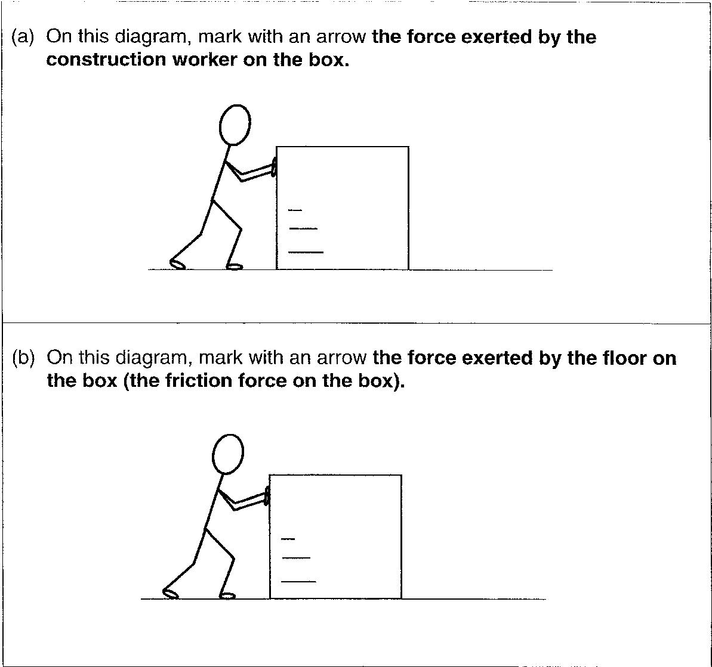
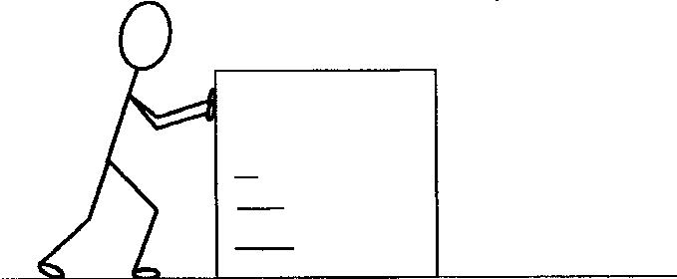
How well are force diagrams drawn?
The box here is being pushed to the right.
Notes:
Friction must be in the plane of the floor and the push starting from the man’s hands

Slide 24
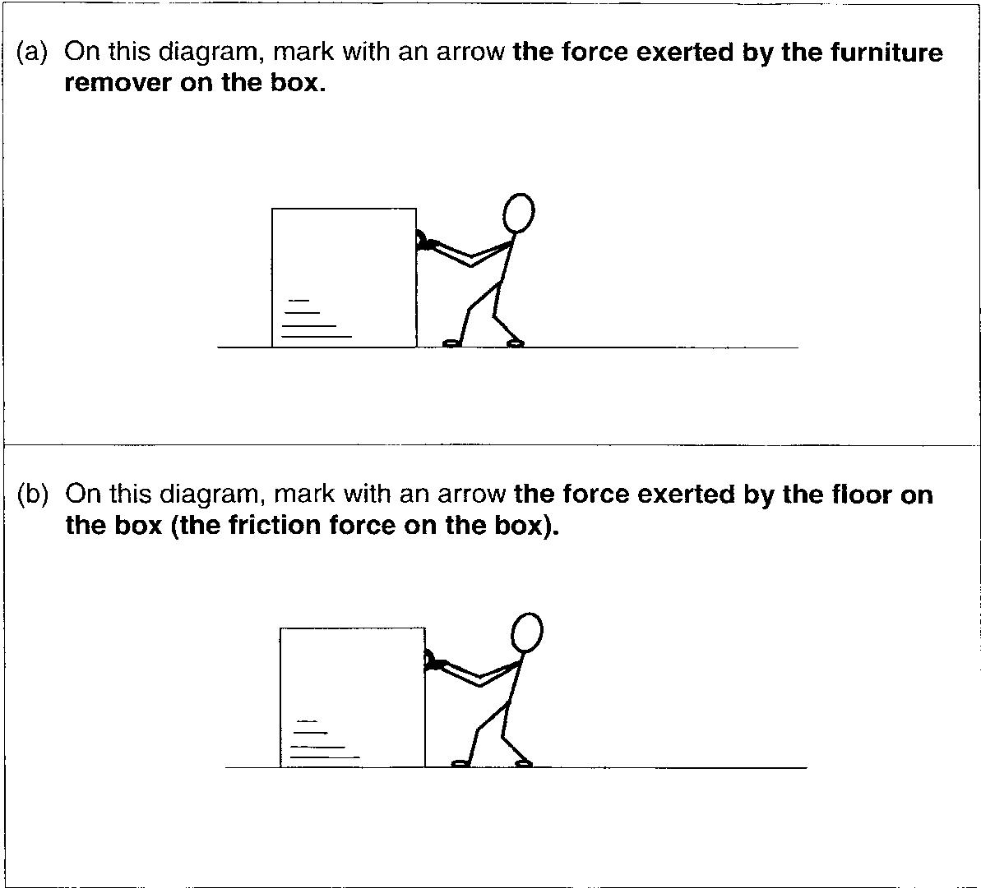
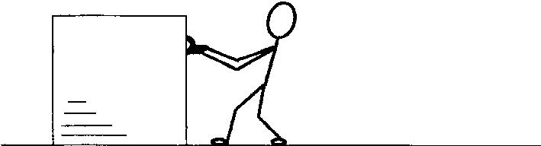
How well are force diagrams drawn?
The box is being pulled to the right.
Add the weight of the box and the supporting force from the floor.
Notes:
Here weight starting from the middle of the box and pull to the right starting from the man’s hands, as well as the push from the floor starting from a point between the weight and the near edge of the box to the man.

Slide 25
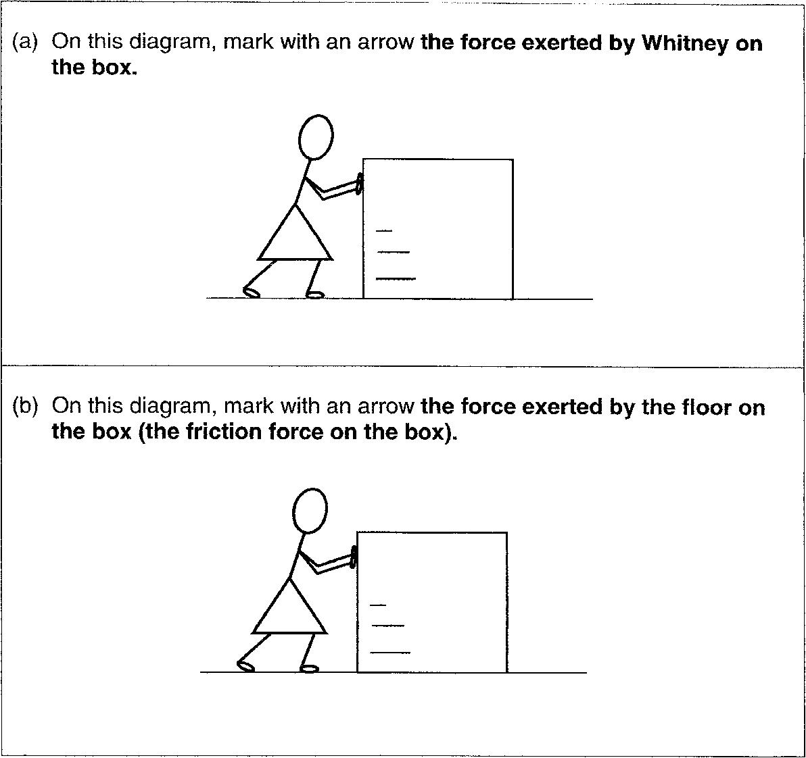
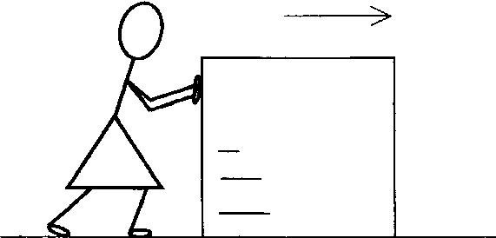
How well are force diagrams drawn?
The box here is just on the point of tipping over.
Add the weight of the box and the supporting force from the floor.
Notes:
Should look same as previous, except the push from the floor is as far to the right as possible.

Slide 26
Notes:
The supporting force when on the point of tipping over must be as far to the right of the box as possible. The supporting force moves to the right because the anticlockwise couple provided by weight and support must equal the clockwise couple provided by push and friction. This is only clear when force arrows are drawn in the correct places.

