Slide 1
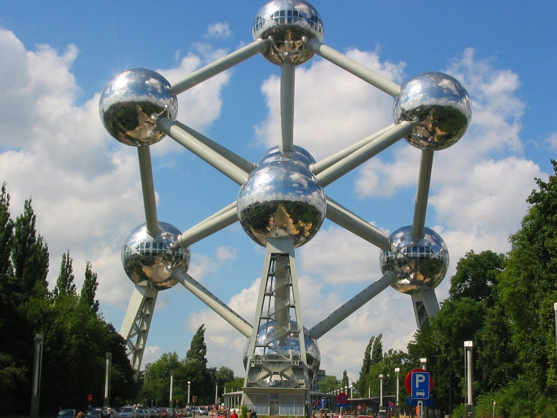
Mathematical and Scientific Modelling: do we tend to neglect one in favour of the other?
Ian Galloway
Copernican Revolutions
Sharing Inspiration, Brussels 2019

Slide 2
Notes:
In this question a teacher might easily have a good understanding of the scientific model required to answer the question, momentum being unchanged during a collision, but only have a rudimentary understanding of the mathematical model, vector algebra, to be able to answer the question correctly.

Slide 3
So what’s the difference?
What is modelling?
What is mathematical modelling?
What is scientific modelling?

Slide 4
modelling
An attempt to describe a physical phenomenon.
The model should make sense at the recipient’s cognitive level.
It should allow prediction and will have limitations.

Slide 5
Mathematical modelling
Algebraic; Equations of motion
Vectorial; force diagrams
Geometric; optics
Graphical; Damped oscillations
Numeric; areas, volumes, CFD

Slide 6
Scientific modelling
Diagrams; schematic, Sankey
Metaphors; delivery van circuit
In vivo, in vitro; lab rats, tissue culture
Physical objects; water circuit
Fictional objects; Bohr model
Analogical; Faraday’s field lines
Computer simulations; nuclear reactors
Mathematical; equations etc.
Notes:
Ability to explain past and future. Good fit to empirical data. Refutable, degree of confidence in model.

Slide 7
Ptolemy and Copernicus
Ptolemaic epicycles.
Heliocentric system
The centre of the earth is not the centre of the universe, but only of gravity and of the lunar sphere

Slide 8
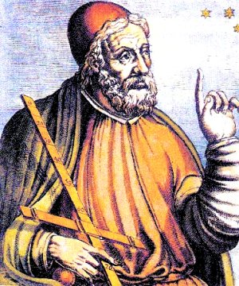
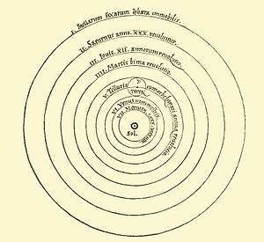
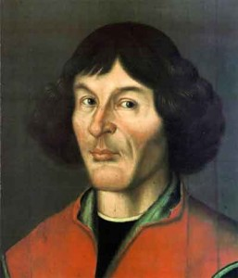
Notes:
The Ptolemaic Cosmos reigned supreme for over a thousand years and yet it was built only upon the mathematical model of epicyles. It was Copernicus who added some scientific modeling and presented the heliocentric system first put forward by Aristarchus some 500 years before Ptolemy. The elliptical orbit had to wait until Kepler. Copernicus’s book De Revolutionibus Orbium Coelestium marked the beginning of the scientific revolution, the first serious attempt to combine scientific and mathematical models to further our understanding of the universe.

Slide 9
“This is indeed a mystery,” [remarked Watson] “What do you imagine that it means?”
“I have no data yet. It is a capital mistake to theorise before one has data. Insensibly one begins to twist facts to suit theories, instead of theories to suit facts.”
Sherlock Holmes, A. Conan Doyle
A Study in Scarlet

Slide 10
Kepler and Newton
Music of the spheres
Hypotheses non fingo

Slide 11
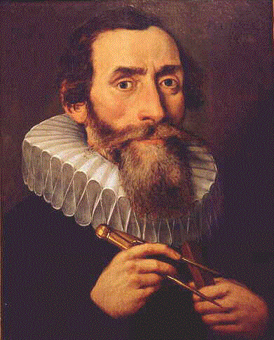
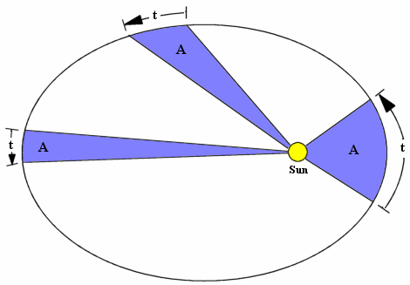
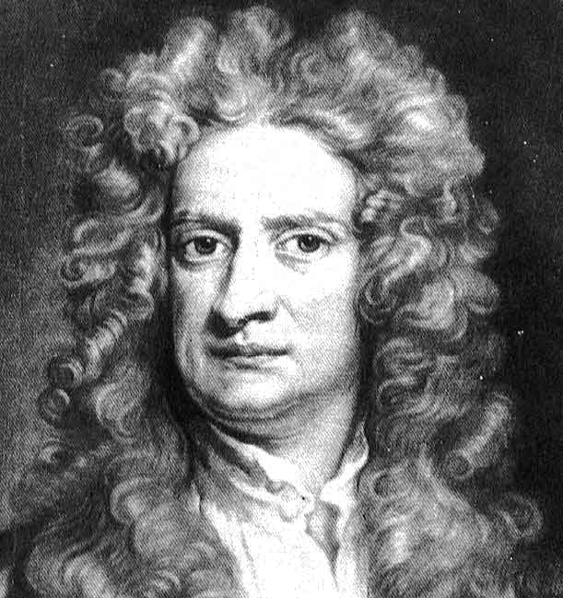
Notes:
Kepler spent years juggling with numbers to finally come up with his famous laws of planetary motion. They were entirely mathematical models and so was his idea for the cosmos….the music of the spheres! This model (the Platonic solids embedded in spheres one within the other) had no basis at all in any scientific ideas and it remained for Newton to combine his scientific model of gravitation with his analysis of angular momentum to yield Kepler’s Laws as a logical outcome.

Slide 12
Faraday and Maxwell
Field lines. Description of magnetic fields to explain the phenomenon of electromagnetic induction.
Maxwell incorporated Faraday’s field lines into his famous equations to provide a complete description of the field.

Slide 13
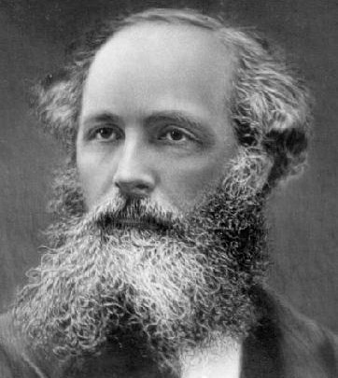
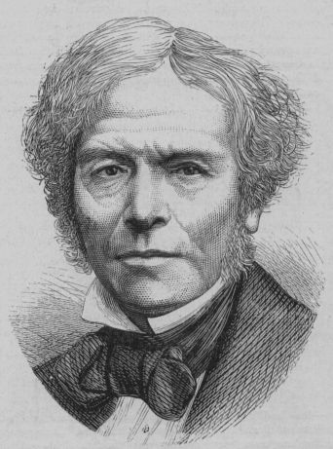
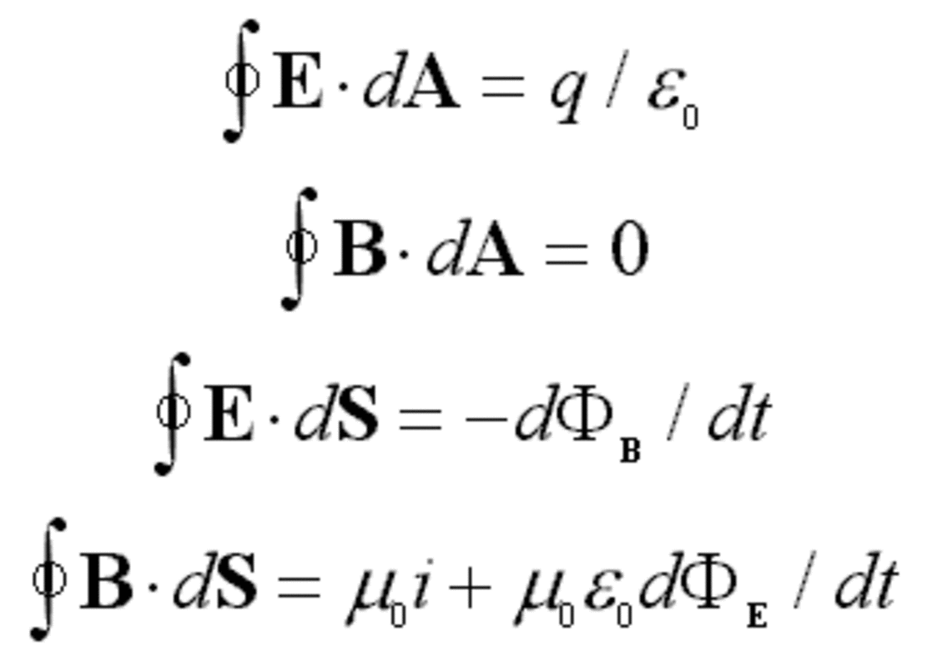
Notes:
Faraday constructed a scientific model of magnetic fields by imagining they behaved like lines of elastic under tension. It modelled qualitatively they way current carrying conductors behaved in magentic fields. Faraday was unable to model these filed lines mathematically but this was later achieved by Maxwell who paved the way for special relativity, televisions and the whole field of electromagnetism.

Slide 14
$$C=\frac{1}{\sqrt{μoєo}}$$
Models light as a transverse electromagnetic wave
Notes:
Maxwell predicted the existence of the entire spectrum of electromagnetic waves and further calculated that they would travel at a speed which corresponded to the then known speed of light. Maxwell concluded that light was a transverse electromagnetic wave.

Slide 15
Planck and Einstein
Resolved Black Body radiation problem by proposing that matter obeyed the Planck Black Body Radiation Law.
Resolved the photoelectric effect by proposing that energy was quantised and so gave birth to quantum mechanics.

Slide 16
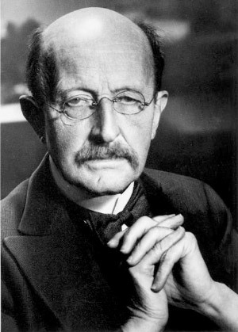
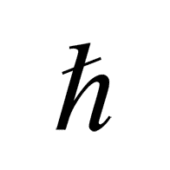
Notes:
Planck believed his own model was a mathematical trick and had no basis in reality. Einstein believed otherwise and constructed a scientific model which extended Planck mathematical model and ultimately became quantum mechanics

Slide 17
Closer to home
Why do we like fitting curves to bridges and arches?
What does it matter if it is a parabola or a quartic which fits a suspension cable?
Should we not at least be considering why a mathematical model fits the data?
Parabolas and catenaries.

Slide 18
Are they different?
I put it to you:
Mathematical models lie in the realm of logical knowledge. They seek no a priori underpinnings but may be drawn from a scientific model
Scientific models lie in the realm of empirical knowledge. They cannot by their very nature contribute to scientific theory on their own.

Slide 19
Finally!
When using a mathematical model to fit to data, the scientist should be asking the question “Why do the data fit?”
When using a scientific model to explore a concept the scientist should be seeking to fit a mathematical model to data or asking a mathematician!

