Slide 1
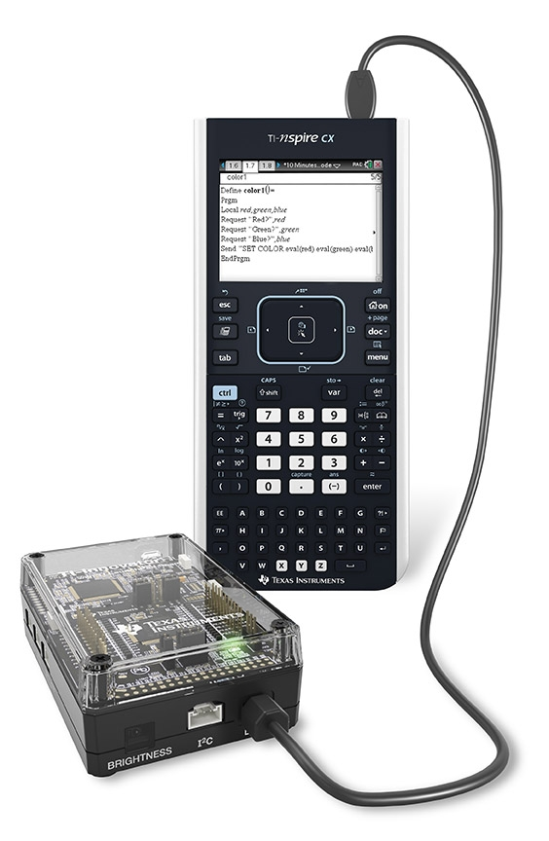
Introduction
Digital Mood Ring with TI-Nspire and
TI-Innovator™ Hub student STEM project
Bring science and coding together (no coding experience necessary) while developing a mood ring! The science of color mixing is explored while determining the right body temperature thresholds.
The project includes variables, loops, conditional statements, Boolean operators and other fundamental concepts in programming

Slide 2
Recommended Path for TI-Innovator™ Projects
Smart Irrigation Project
Pet Car Alarm
10 Minutes of Code
for TI-Innovator™ Hub
Units 1-3
Digital Mood Ring Project
Four Chambered Heart
Music with Code
More in the works…

Slide 3
Learning to do the projects yourself
Step 1: Get a practice kit from the TI STEM Team by filling out the Request Details form at education.ti.com/stemprojects
Step 2: Do the following:
10 Minutes of Code with the TI-Innovator Unit 1. These are step-by-step instructions that will give you a foundation for creating, running and editing TI-Basic programs with the TI-Innovator Hub. Follow this link. Click on Unit 1 and then click step by step to go through the skill builders. (Note: Units 2 and 3 are also useful)
Digital Mood Ring Project. We have found this to be a great first project for doing feedback and control systems. The topic is fun and the set-up is not intimidating. You will cover foundational concepts for programming and for feedback and control systems. After doing this project both adults and students say that the more advanced projects no longer look so overwhelming.
  Make sure to download and follow the “By Challenges” Teacher document and example programs at this link
  Also, we highly recommend a set of YouTube videos that we created based on workshops with teachers preparing to lead summer camps. Follow this link.
You are ready for advanced projects. Go to the STEM Projects home page to find your project. https://education.ti.com/en/resources/stem-projects Go to the project of your choice. Download the teacher document, example programs and any other files from this page. Work through the challenges in the teacher document.
Contact STEM-team@ti.com with questions or comments about the projects.

Slide 4
TI-Nspire CX Resources:
Step-by Step YouTube videos designed for the teacher with a detailed, demonstration of each challenge. The videos are intended to guide those new programming in general, programming on the TI-84 Plus CE and programming with the TI-Innovator Hub.
  https://www.youtube.com/playlist?list=PL17Fe0ZmhCR_j09b202PUI0wfaRYSLQka
10 Minutes of Code Teacher’s Lounge (TI-Nspire CX): For a single download of all lessons for 10 Minute of Codes for the TI-Nspire CX in PDF’s:
  https://education.ti.com/en/activities/ti-codes/nspire/teacher-lounge
TI-Innovator Technology eGuide
  https://education.ti.com/html/webhelp/EG_Innovator/EN/index.html
TI-Innovator Hub Commands
  https://education.ti.com/html/webhelp/EG_Innovator/EN/content/eg_innovsys/resources/pdf/ti-innovator_hub_commands_en.pdf
TI-Nspire CX Programming Editor Guide
  https://education.ti.com/html/webhelp/EG_TINspireCode/EN/index.html
YouTube Video (informal, but TI produced) gives you the basics of writing and running TI-Nspire programs that control the TI-Innovator.
  https://www.youtube.com/watch?v=2jjncu8Aba0

Slide 5
Digital Mood Ring Challenges
Challenge 1: Use SET COLOR to explore using the color LED. Try to find the RGB values of all the colors in the mood chart.
Challenge 2: Use DispAt command to display your name at several locations on the screen.
Challenge 3: Use a For..EndFor loop to display the numbers 1 through 10.
Challenge 4: Connect a temperature sensor to the TI-Innovator Hub and display the temperature on the calculator.
Challenge 5: Use a loop to read and display temperature.
Challenge 5 Extension (Optional): Use a loop to read, display and log into list arrays for time and temperature. Graph the result.
Challenge 6: Use a While..EndWhile loop along with getKey() command to monitor temperature and make a decision to display a message, “Hot” or “Cold”. Then modify your program to include a 3rd level between hot and cold, “Nice”.
Final Challenge: Build a mood ring to repeatedly read the temperature sensor, determine the mood of the person, display the temperature value and display the mood.
Use “Digital Mood Ring by challenges” document at URL http://bit.ly/2oqU1X8

Slide 6
Summary of programming concepts in the project
Control of a red-green-blue LED output
  Send “SET COLOR 255 0 0”
Display of text strings, variable values and expressions
  DispAt 5,“Temperature=“,t,”°C”
  DispAt 4,”Time=“,n*0.5,”sec”
For loops to repeat a set of commands a specified number of times
  For n,1,10
  commands within loop
  EndFor
Connecting, reading and getting to a variable temperature sensor inputs
  Send “CONNECT TEMPERATURE 1 TO IN 1”
  Send “READ TEMPERATURE 1”
  Get t
Storing variables to variables using the assign operator, :=
  f:=9/5 x t+32
List variables of a set of values and accessing individual elements of the list using the position number.
  time:={0.5,1,1.5,2}
  time[5]:=2.5
  True/False comparison operators used in conditional statements for program control: =,≠,<,≤,>,≥
Assignment of initial values to variables to give the program known starting points.
  key:=“ “
  time:={ }
While loops to repeat a set of commands while a condition is true
  While key≠”esc”
  commands within loop
  EndWhile
Keyboard inputs using the TI-Nspire getKey command that returns a text string of the name of the last key pressed
  key:=getKey()
If-Then conditional statements that do a set of commands if a condition is true and are skipped if the condition is false
  If t<22 Then
  commands within If-Then block
  EndIf
Boolean operator and to require two conditional statements to be true for the entire statement to be true
  If t≥22 and t<25 Then

Slide 7
Summary of TI-Nspire concepts and skills
Home/On key to turn the calculator on and to return to the home screen, which is a jumping off point for managing the calculator.
TI-Nspire document files combine a set of pages containing apps. Apps include calculator, program editor, grapher and others.
Home screen document management includes
  New document to start a new document file
  My Documents to view and manage documents
  Current returns to the document that is open
Select from menus using arrow keys and enter or by the shortcut of the number or letter preceding the menu item
The keyboard is divided into three sections:
  Alpha entry (bottom)
  Math entry (middle)
  Navigation and document management (top)
Press and release the ctrl key to access function labeled above the keys.
esc key to back out of menus and dialogues
ctrl-z to undo, ctrl-c to copy, ctrl-x to cut, ctrl-v to paste
ctrl-s to save the document
The delete key is a destructive backspace
  ctrl-doc key (+page) to add a page to a document
  Move from page to page in a document by using ctrl left arrow and ctrl right arrow or by using the touchpad to move the pointer to the page number tab and center clicking
  The menu key brings up selections that are available in each app
Use the program editor app to create and edit programs.
Use Check Syntax and Store to update changes made to programs before running the program.
  ctrl-r and ctrl-b are useful shortcuts on the Check Syntax and Store menu.
  ctrl-r, Run, checks syntax, stores and pastes the program name to a calculator page
Programs are run on the calculator app
  Type or paste the program name on a blank row, then press enter to run the program
Use the var, variable, key to view and access the variables in a document
Use the catalog (book symbol) key to see a menu of all the functions in the calculator

Slide 8
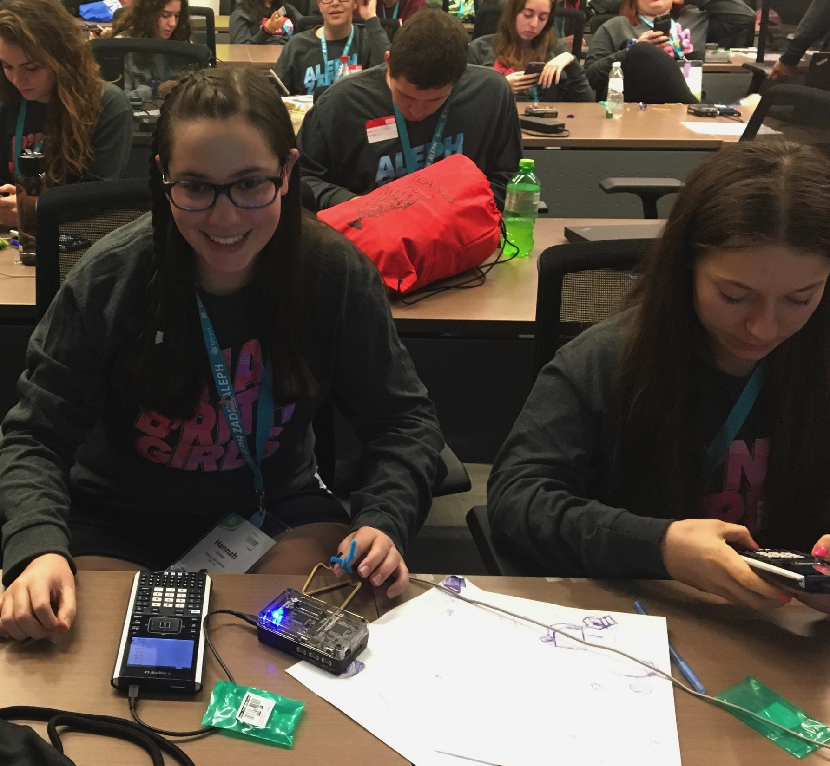
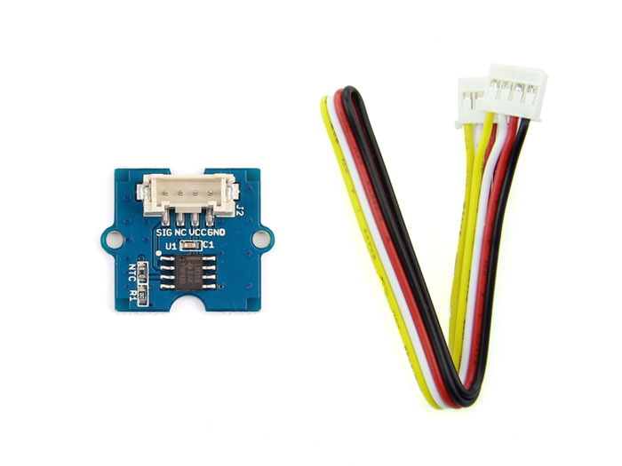
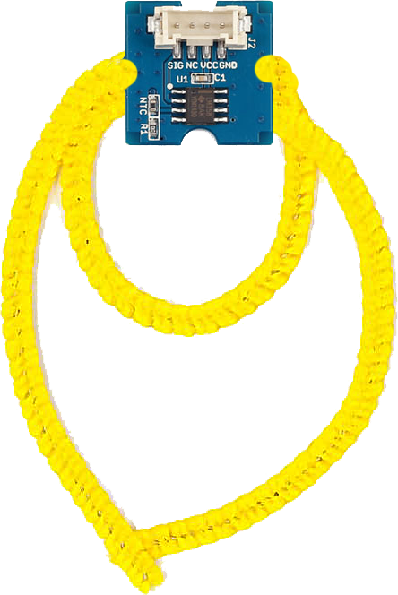
Digital Mood Ring (introduction to STEM and coding Projects for all levels)
Bring science and coding together (no coding experience necessary) while developing a mood ring! Explore the science of color mixing while determining the right body temperature thresholds.
This is an excellent first TI-Innovator STEM and coding project. The project includes variables, loops, conditional statements, Boolean operators and other fundamental programming concepts.
Use “Digital Mood Ring by challenges” document at URL http://bit.ly/2oqU1X8

Slide 9
Final Challenge
Digital Mood Ring with TI-Nspire and
TI-Innovator™ Hub student STEM project
Final Challenge: Build a mood ring to repeatedly read a temperature sensor, determine the mood of the person, display the temperature value and display the mood.

Slide 10
Chenille Wire (AKA “Pipe Cleaner”)

Slide 11
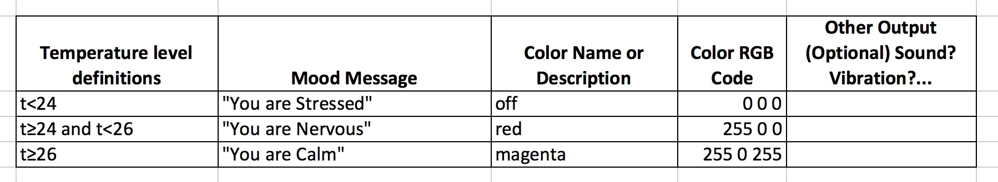
Defining your digital mood ring

Slide 12
Digital Mood Ring for TI-Nspire
Simple Example Program
Send "CONNECT TEMPERATURE 1 TO IN 1"
key:=” "
DispAt 8,”Press esc key to quit”
While key≠"esc”
key:=getKey()
Send "READ TEMPERATURE 1”
Get t
DispAt 4,"Temp =",t,"°C”
If t<24 Then
Send "SET COLOR 0 0 0”
DispAt 5,"You are STRESSED”
EndIf
If t≥24 and t<26 Then
Send "SET COLOR 255 0 0”
DispAt 5,"You are NERVOUS”
EndIf
If t≥26 Then
Send "SET COLOR 255 0 255”
DispAt 5,"You are CALM”
EndIf
Wait 0.5
EndWhile
Send "SET COLOR 0 0 0”

Slide 13
Digital Mood Ring for TI-Nspire
Simple Example Program
Send "CONNECT TEMPERATURE 1 TO IN 1"
key:=” "
DispAt 8,”Press esc key to quit”
While key≠"esc”
key:=getKey()
Send "READ TEMPERATURE 1”
Get t
DispAt 4,"Temp =",t,"°C”
If t<24 Then
Send "SET COLOR 0 0 0”
DispAt 5,"You are STRESSED”
EndIf
If t≥24 and t<26 Then
Send "SET COLOR 255 0 0”
DispAt 5,"You are NERVOUS”
EndIf
If t≥26 Then
Send "SET COLOR 255 0 255”
DispAt 5,"You are CALM”
EndIf
Wait 0.5
EndWhile
Send "SET COLOR 0 0 0”
Setup
Inputs
While Loop
Outputs
Clean up

Slide 14
On to the final challenge
Digital Mood Ring with TI-Nspire and
TI-Innovator™ Hub student STEM project

