Slide 1
t3turkey.com

Slide 2
From CBR to TI Innovator Hub, Metamorphosis of a Math Teacher
Sharing Inspiration 2021
September 16, 2021
Tonguç Özdaş Uğur Mert Yunus Emre Doğan
t3turkey.com

Slide 3
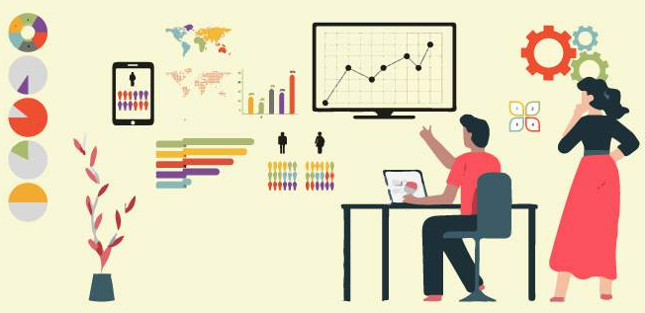
Outline
A brief discussion on Computational Thinking
Using ready-to-use data & Hands-on data
Using a data collector
Programming a sensor to collect data
*
t3turkey.com
*https://www.analyticssteps.com/blogs/5-statistical-data-analysis-techniques-statistical-modelling-machine-learning

Slide 4
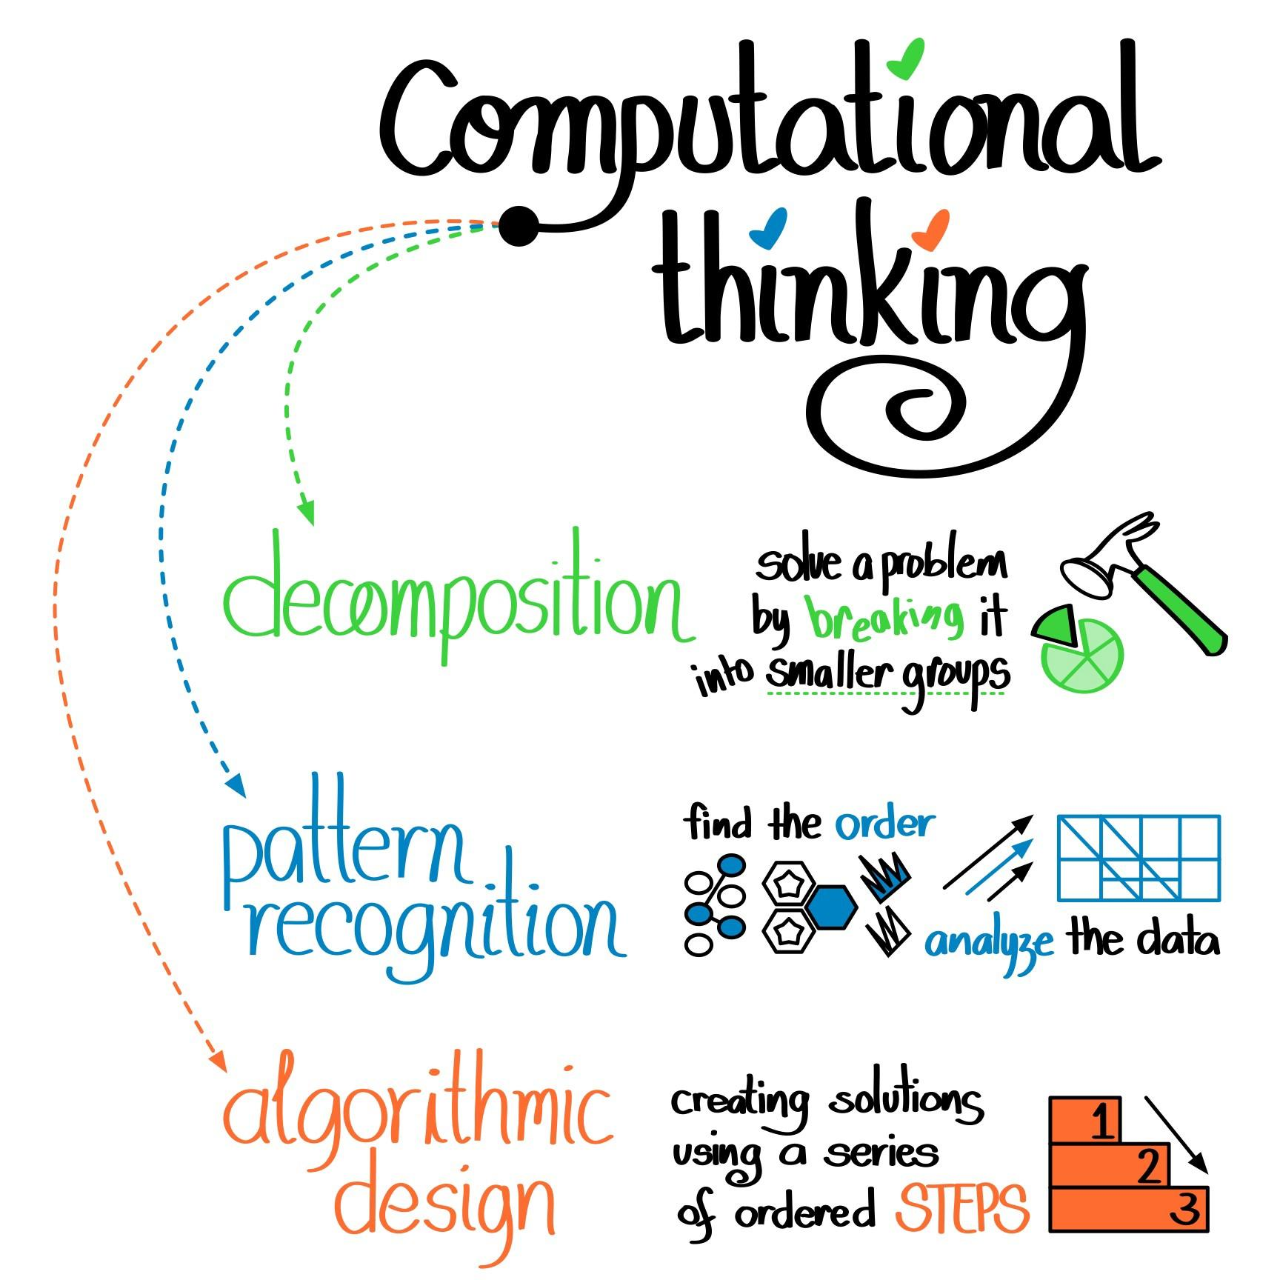
Section 1: Data Analysis on Ready-to-use Datasets
Section 1: Data Analysis on Ready-to-use Datasets & Hands on Data
*
A brief discussion on Computational Thinking
Mathematical Modelling
Data Literacy
Ready-to-use data sets (Textbook data)
Error free
No room for authenticity
t3turkey.com
*https://medium.com/pythonforkids/lesson-1-computational-thinking-f02fa49ac82b

Slide 5
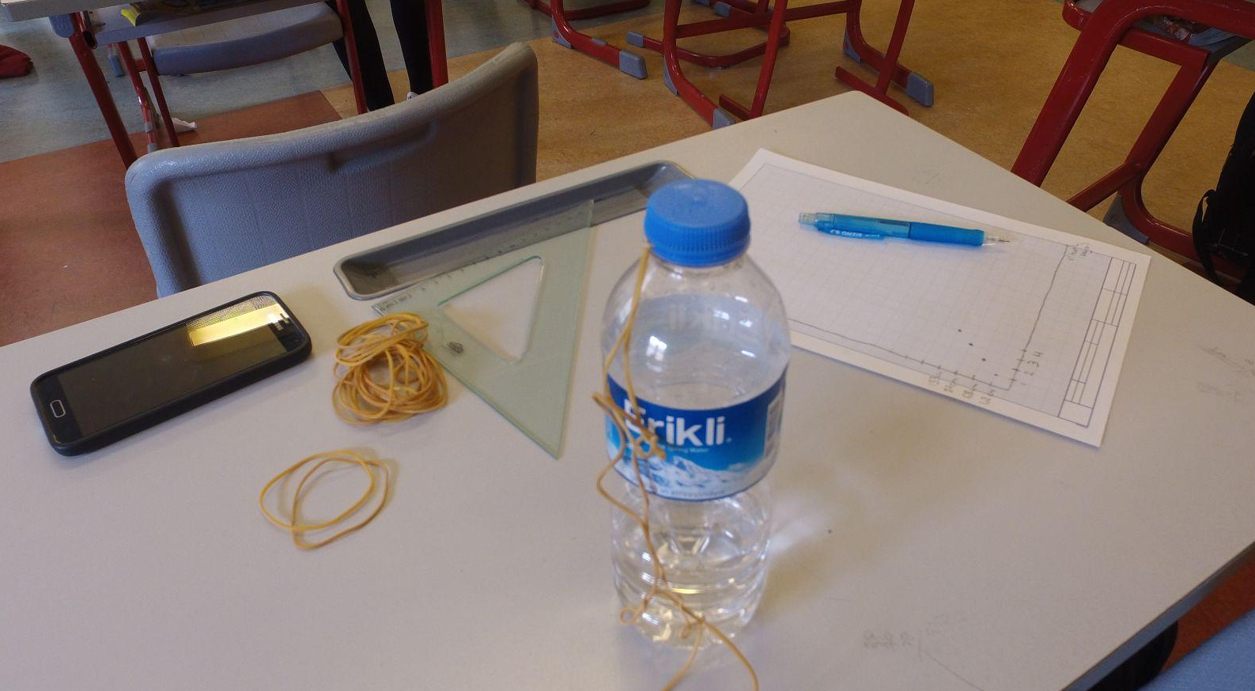
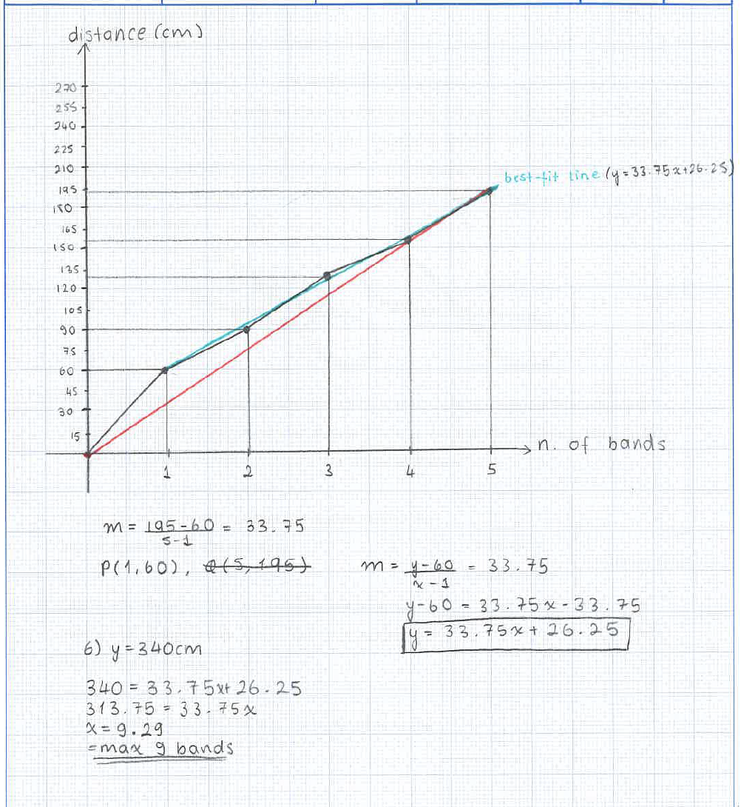
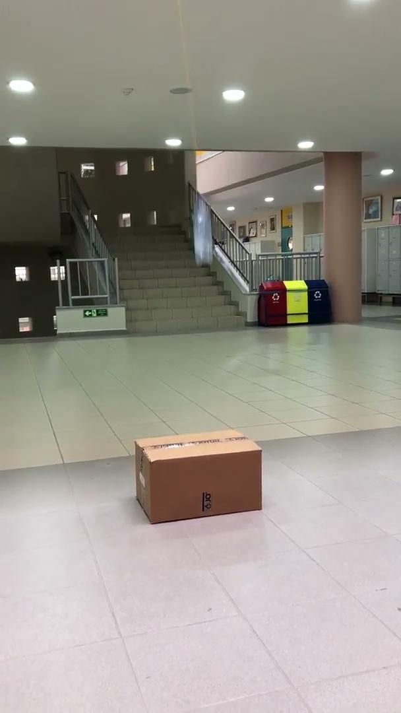
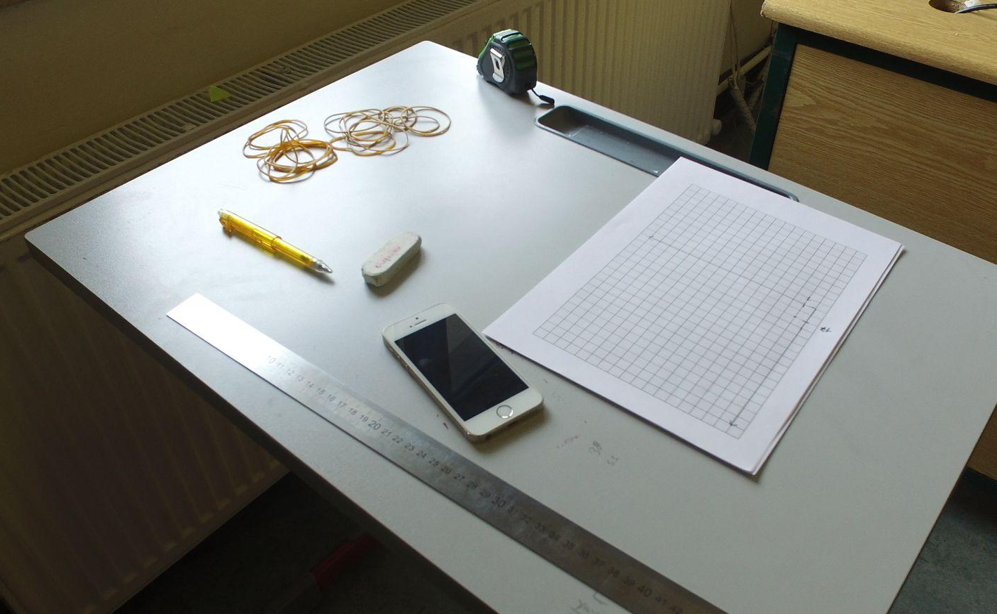
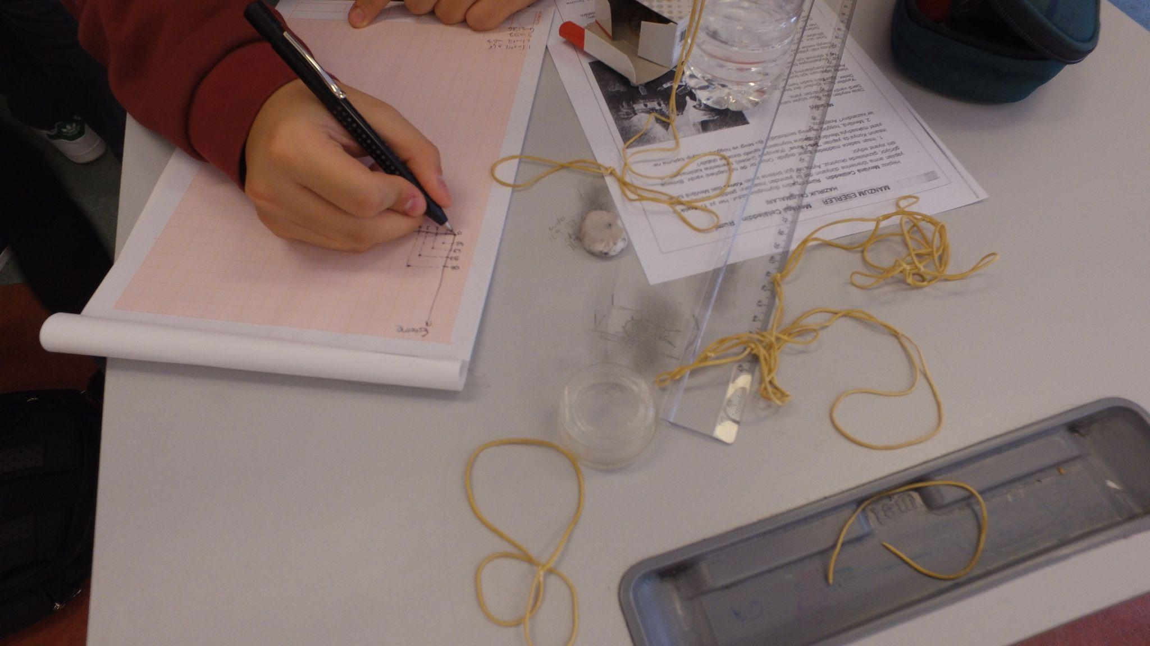
Section 1: Data Analysis on Ready-to-use Datasets & Hands on Data
t3turkey.com

Slide 6
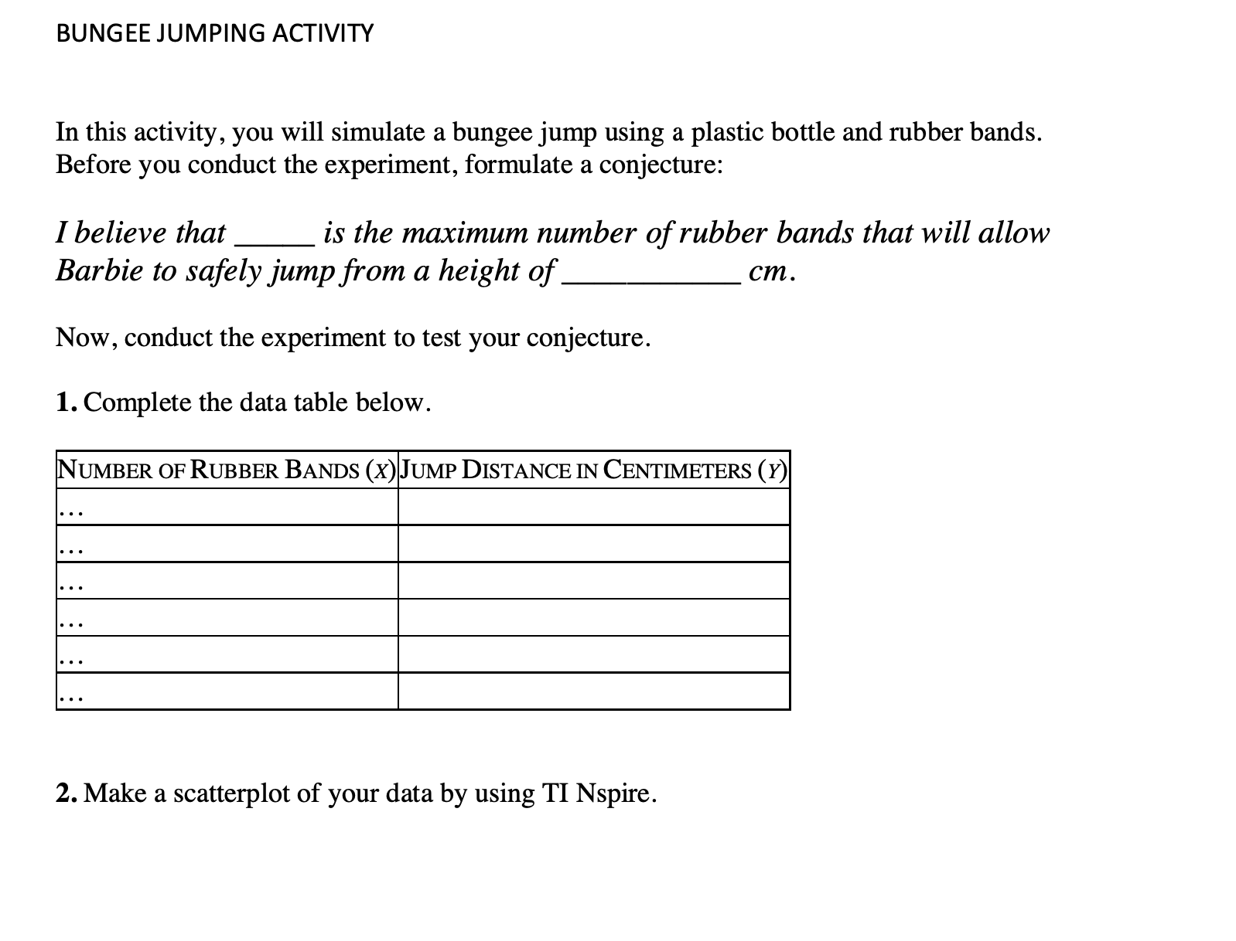
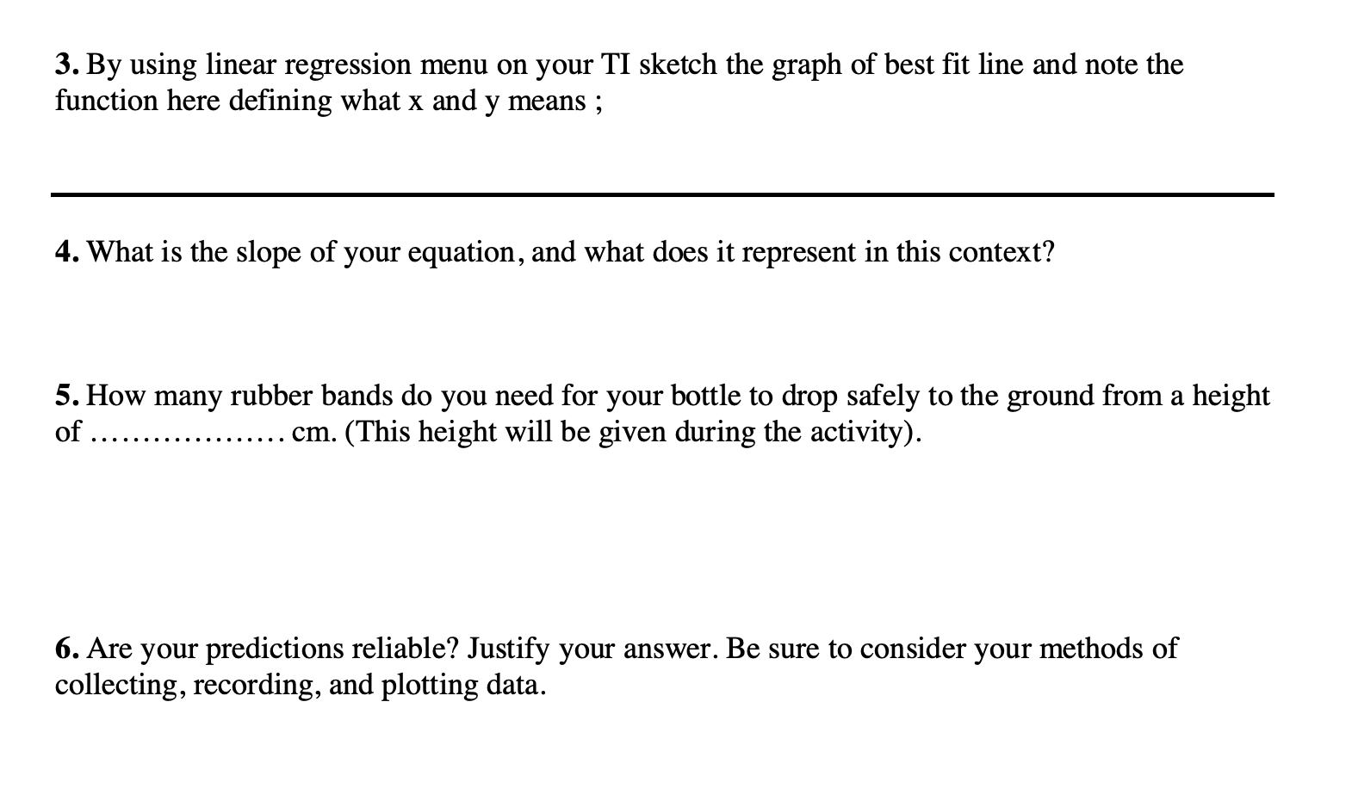
Section 1: Data Analysis on Ready-to-use Datasets & Hands on Data
t3turkey.com

Slide 7
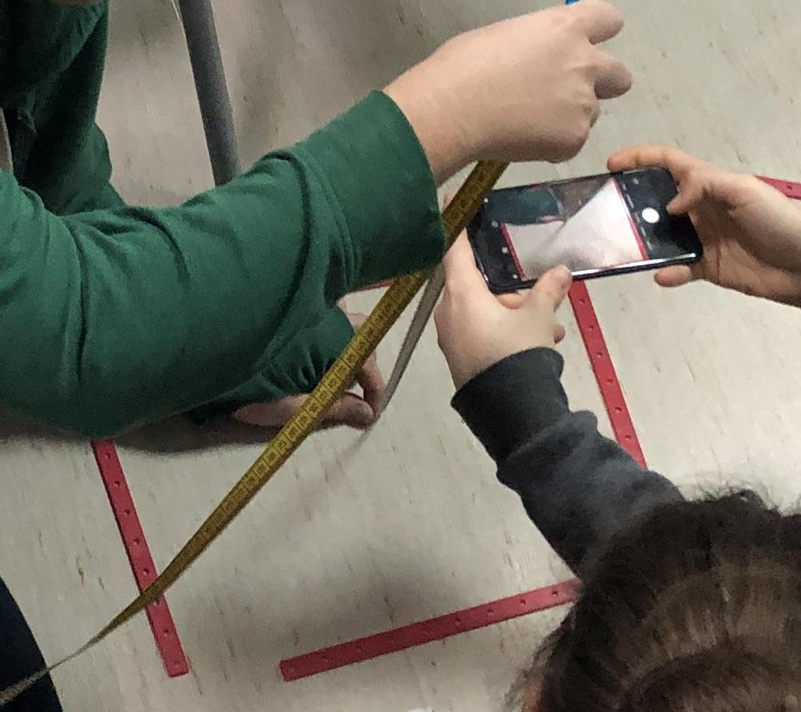
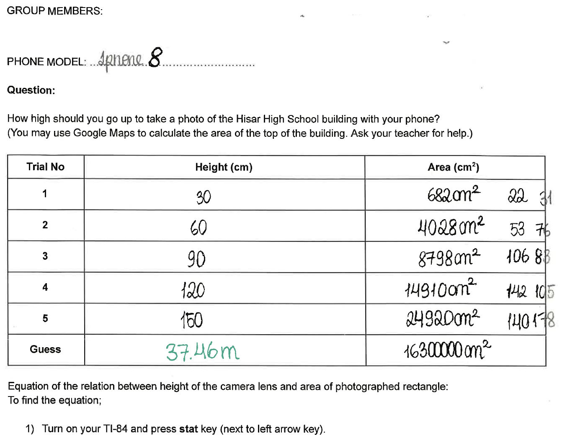
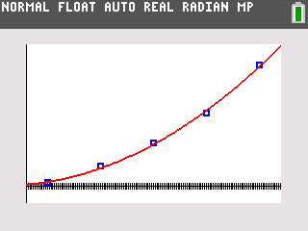
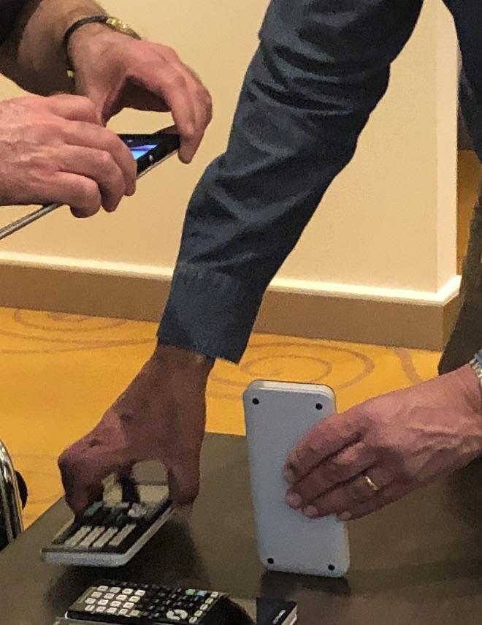
Section 1: Data Analysis on Ready-to-use Datasets & Hands on Data
t3turkey.com

Slide 8
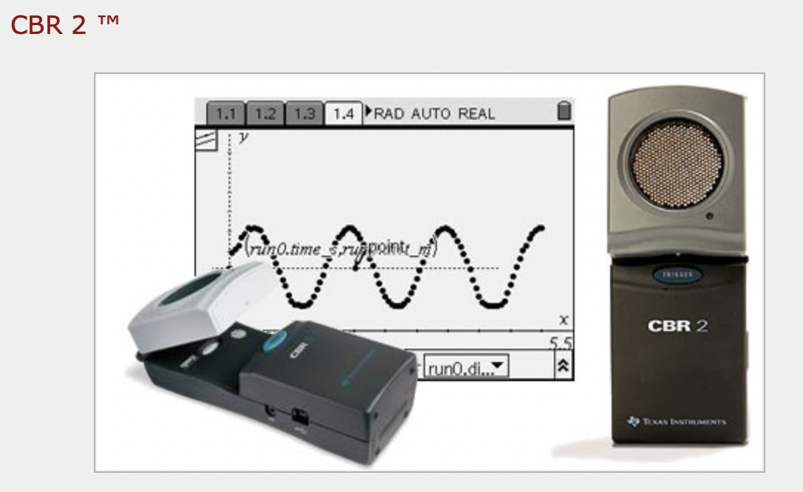
Section 2: Using a Data Collector to Collect Data
Functions & Relations
Linear Functions
Absolute Value Functions
Quadratic Functions
Trigonometric Functions
Equation of Circle
t3turkey.com

Slide 9
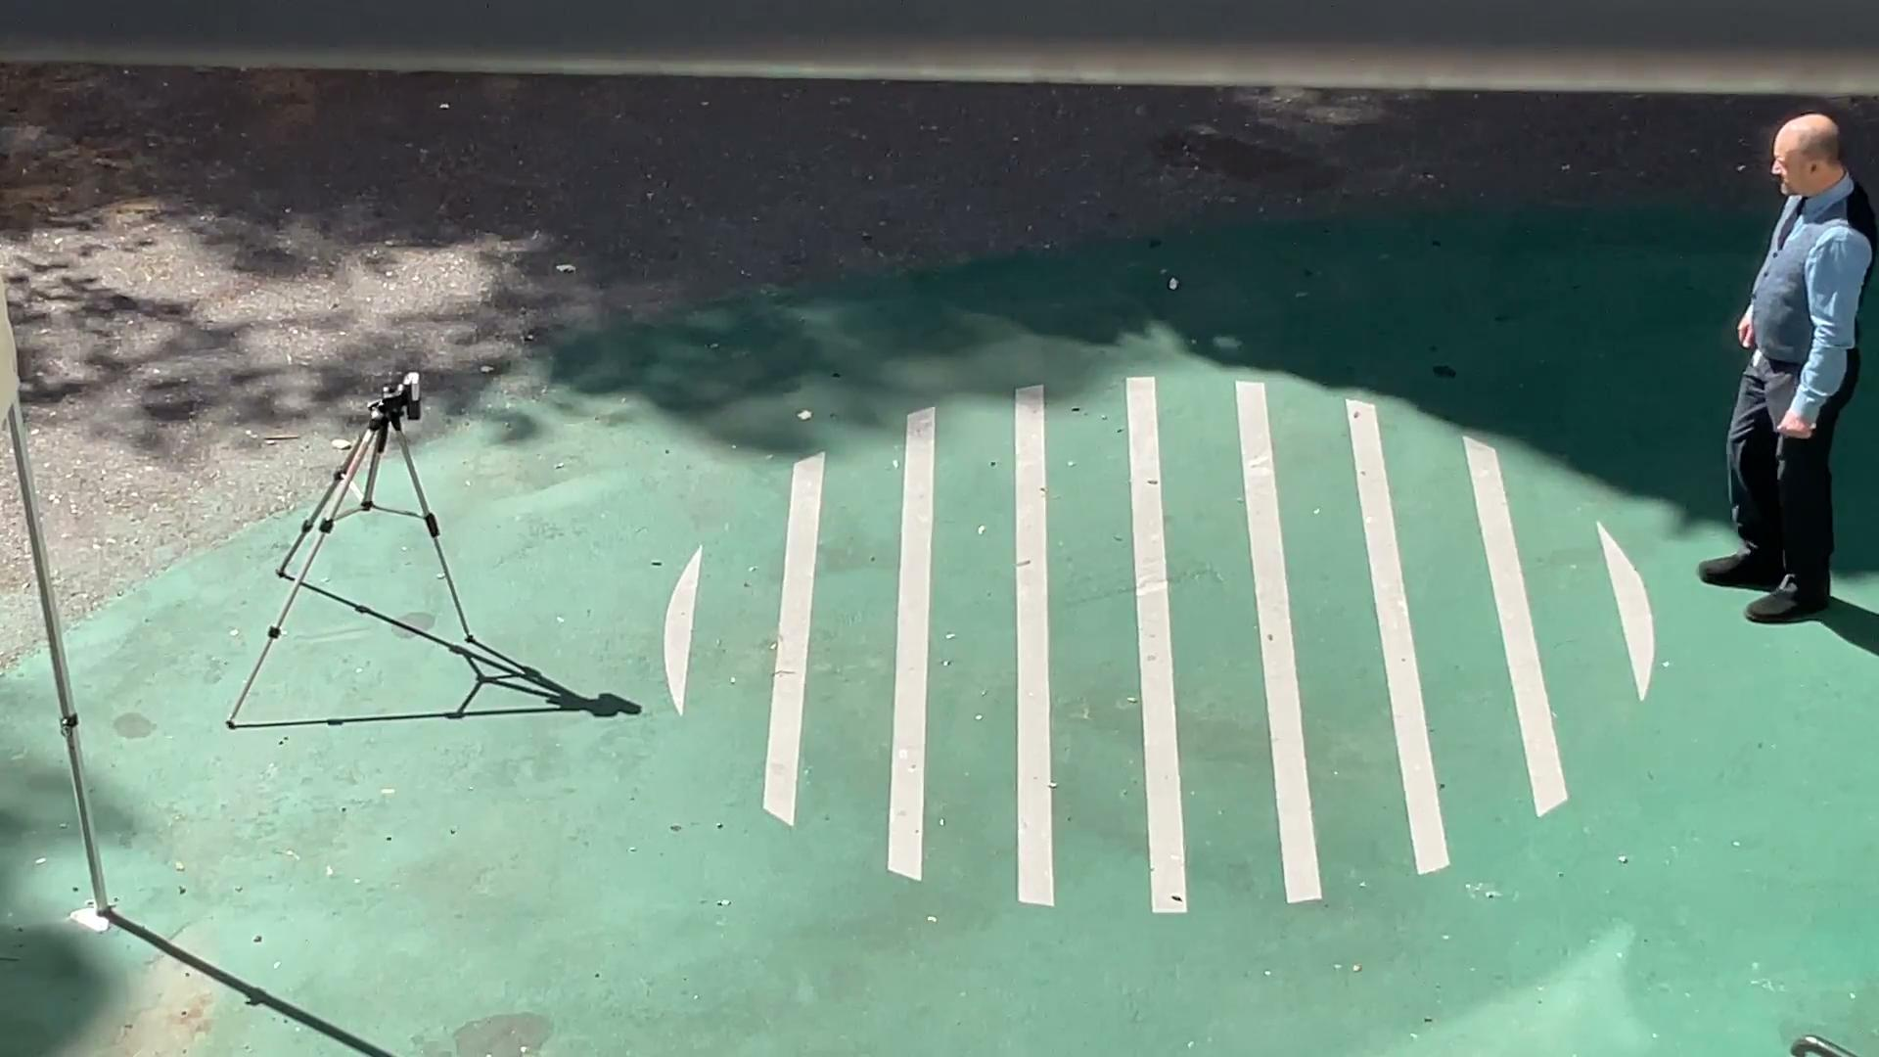
Section 2: Using a Data Collector to Collect Data
Functions & Relations
Linear Functions
t3turkey.com

Slide 10
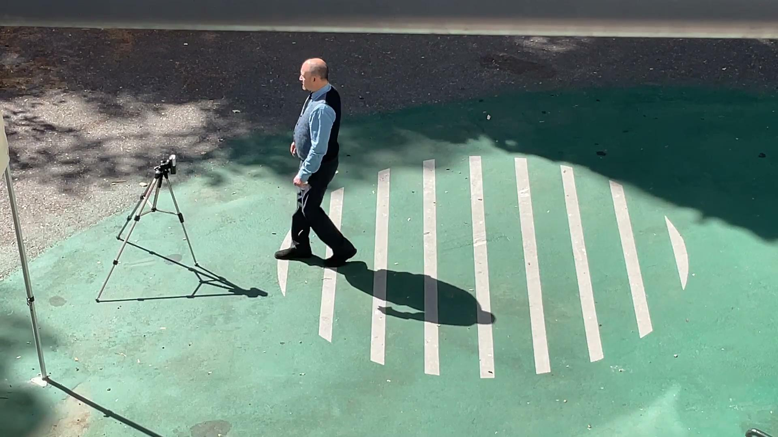
Section 2: Using a Data Collector to Collect Data
Functions & Relations
Absolute Value Functions
t3turkey.com

Slide 11
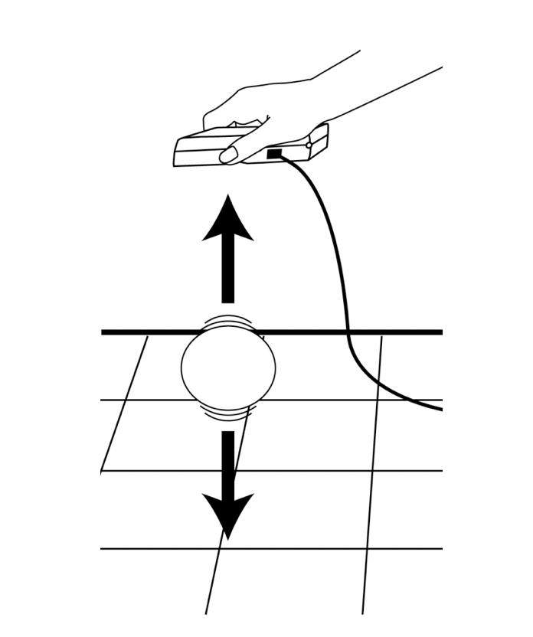
Section 2: Using a Data Collector to Collect Data
Functions & Relations
Quadratic Functions
t3turkey.com

Slide 12
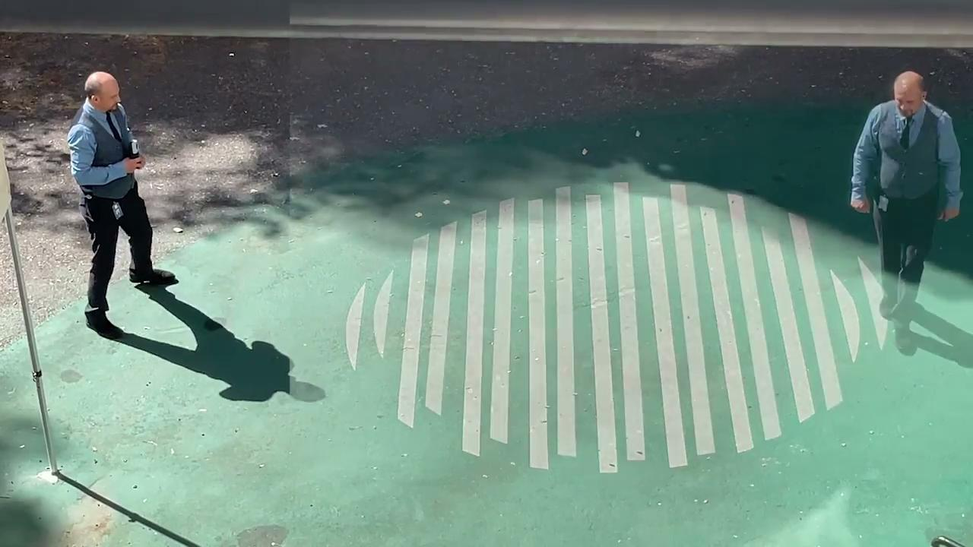
Section 2: Using a Data Collector to Collect Data
Functions & Relations
Trigonometric Functions
Equation of Circle
t3turkey.com

Slide 13
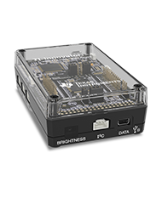
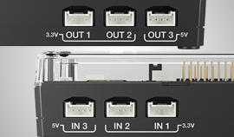
Section 3: Programming a Sensor to Collect Data
TI Innovator Hub
t3turkey.com

Slide 14
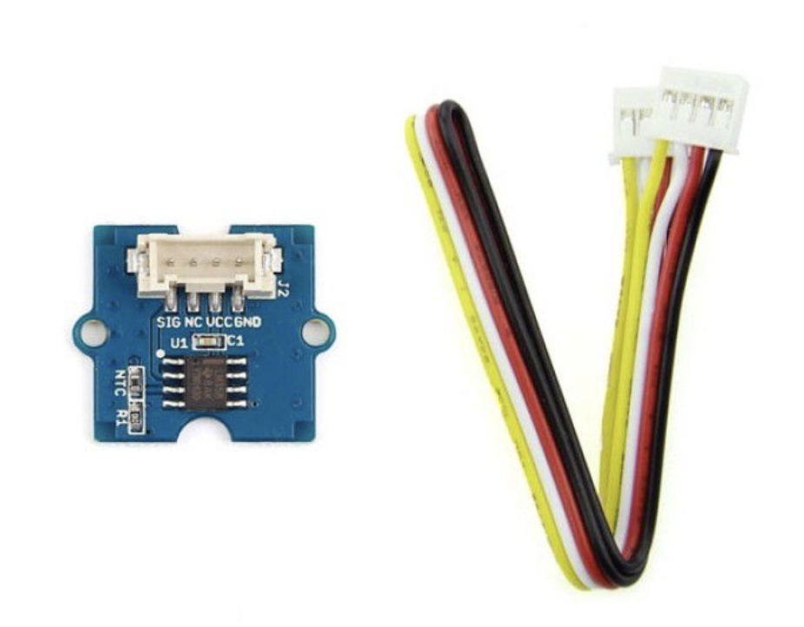
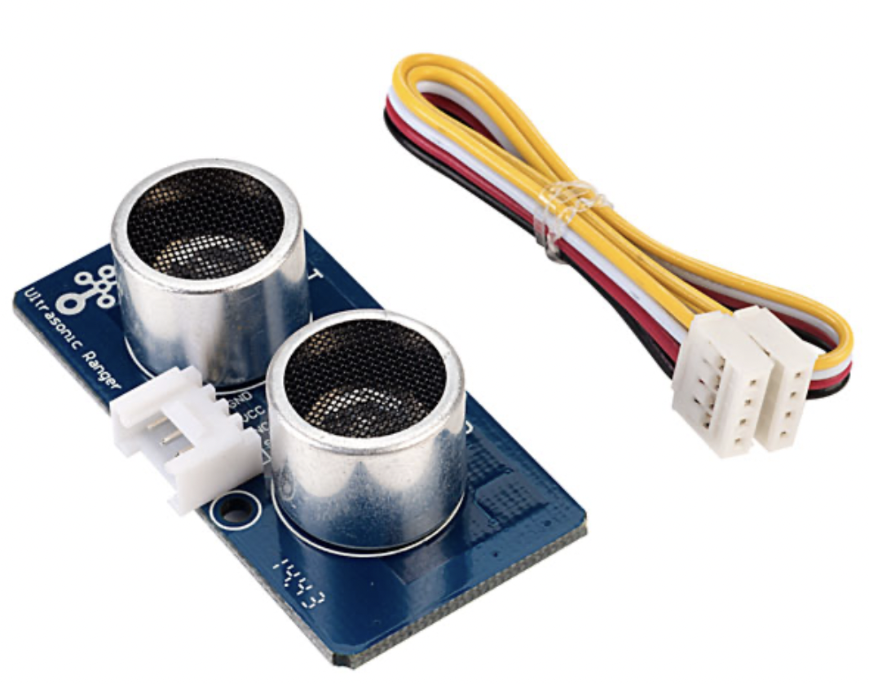
Section 3: Programming a Sensor to Collect Data
Ultrasonic Ranger
Thermistor
t3turkey.com

Slide 15
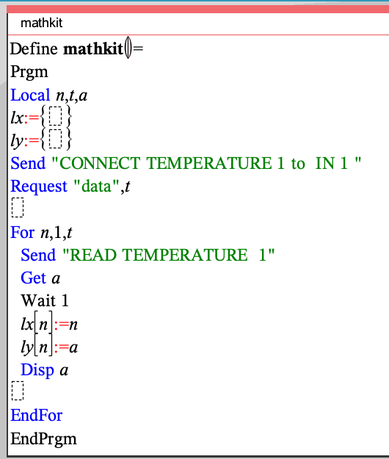
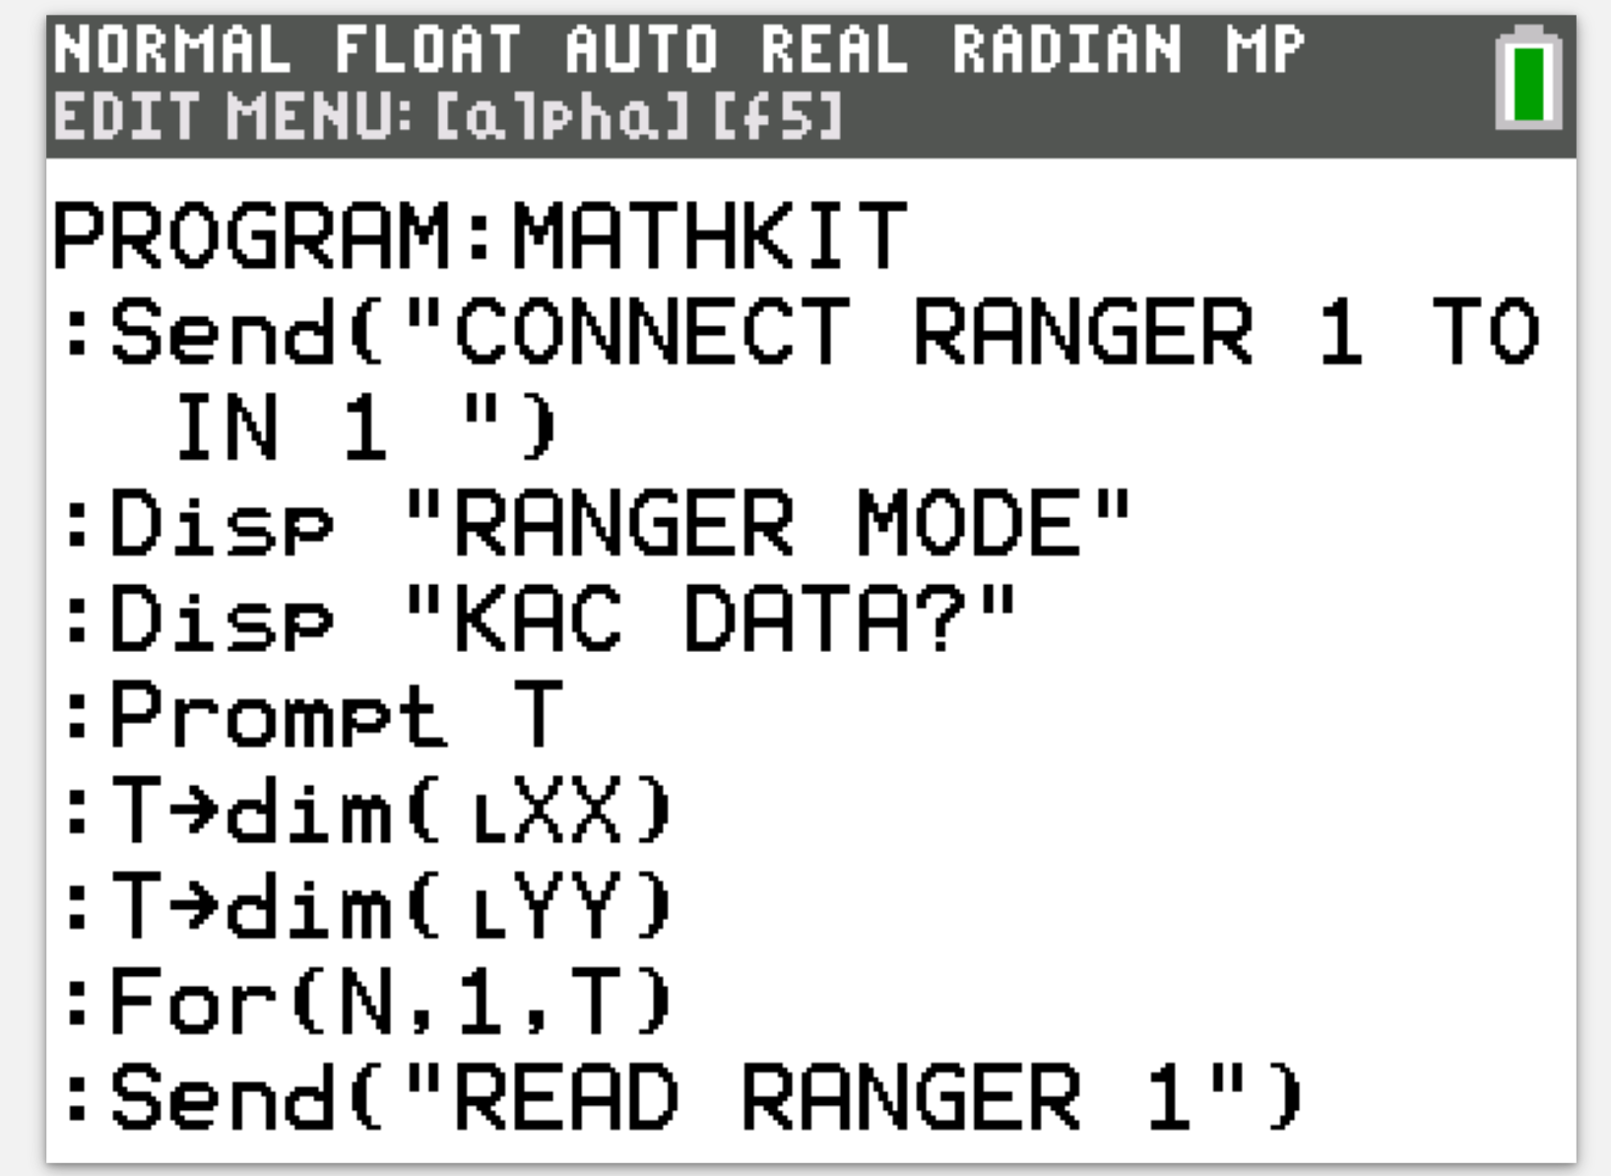
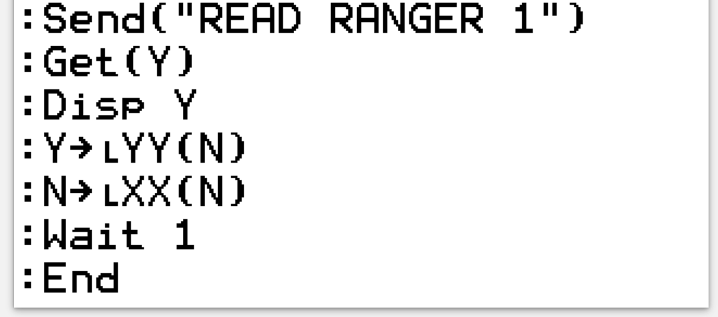
t3turkey.com

Slide 16
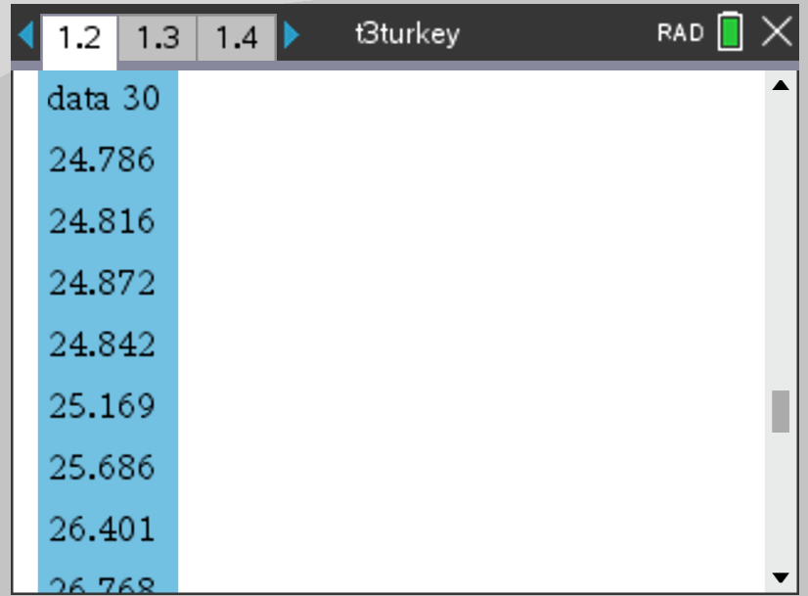
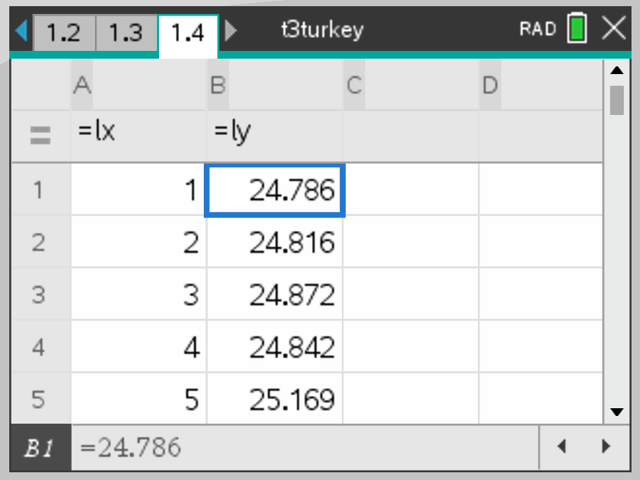
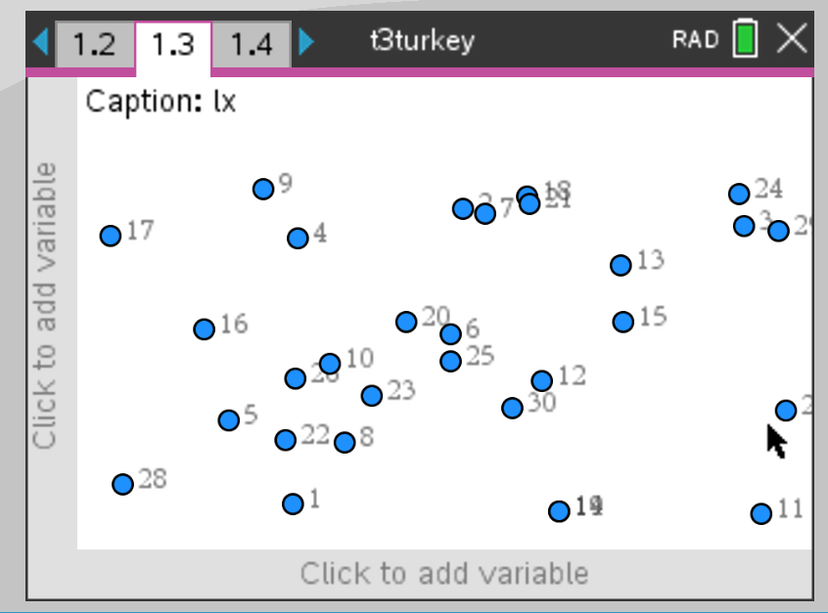
Section 3: Programming a Sensor to Collect Data
t3turkey.com

Slide 17
Q&A
Thank you for listening.
Tonguç Özdaş
tozdas@gmail.com
Uğur Mert
ugurmert72@gmail.com
Yunus Emre Doğan
yedogan3@gmail.com
t3turkey.com

